Slide 2

Position: Technical Writing – InternKey Responsibilities:
Assist in authoring and reviewing Aircraft Maintenance Manuals (AMM)
Support the development of IPC and other technical documentation
Interpret engineering drawings, technical data, and maintenance procedures
Ensure compliance with aerospace documentation standards (ATA / S1000D)
Perform proofreading and quality checks for accuracy and consistency
Collaborate with illustration teams to develop and review technical illustrations for manuals
Prepare thoroughly on topics related to Aerospace Technical Writing
Gain a basic understanding of ALTEN India’s vision, mission, and service offerings

Slide 3
Alten -
French Based company
Basically in Engineering, technology consulting and AI driven solutions
Industry or domain such as aerospace, automotive, rail, telecom, and life sciences
ALTEN India Established in 2010.
presence across Bangalore, Chennai, Pune, Hyderabad, Delhi, and Aurangabad
8500 Employee in India
strategic vision,
ALTEN India is focused on accelerating growth, with an ambition to scale 2x over the next
two years through a combination of organic expansion and strategic acquisitions, aligned with the
increasing demand for advanced engineering, digital and AI capabilities in India

Slide 4
AERO TECH PUB
What do you know about aerospace technical publication
Difference between AMM and CMM
What is ATA 100 and S1000D
Why do we use aeronautical tech pub manuals
What is the role of DGCA
What do u know about the job role tech-pub?
If you were asked to pick deliver time or quality which parameter would you focus on ?
Why tech-pub role if you have efficient engineering skills?
Do you know STE?tell me about it
If you were asked to pick on time delivery or quality which one would you pick and why?
Where do you see yourself in upcoming years?
Difference between overhaul maintenance and maintenance?
What do you know about the job role tech-pub and why?
If you were asked to pick deliver time or quality which parameter would you focus on ?

Slide 5
ENGINEERING
Types of engines in aircraft
Explain turboprop engine
What's is gear
Use of bearings
Do you know bernoullis principle
What is turbines and why is it important?
How do you consider the properties of a particular material when selecting it for an engineering application?
Explain me aerodynamic think that i don't know anything about aerodynamics?
APTITUDE OR GENERAL
Why u choosed aeronautical engineering
What you know about Alten
Where do you see yourself in 5 years?
What was your biggest downfall and how did you overcome it?
Tell me about your internship which you have mentioned in resume
Tell me what you know about FEM which you mentioned in your resume

Slide 6
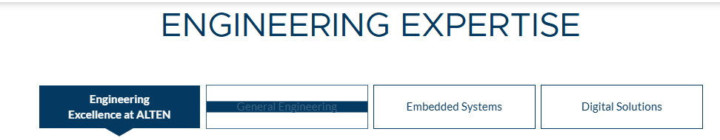

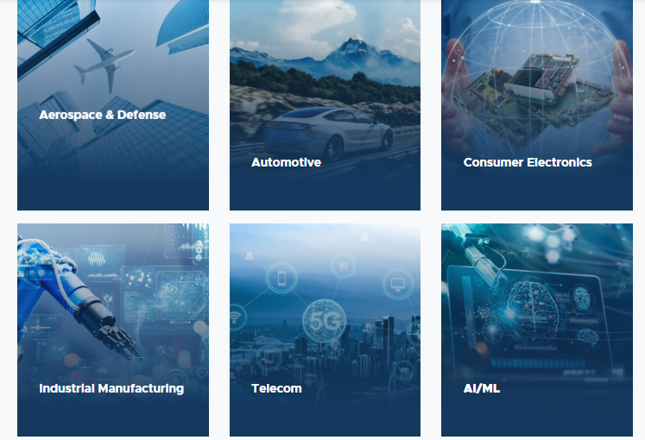

Slide 7
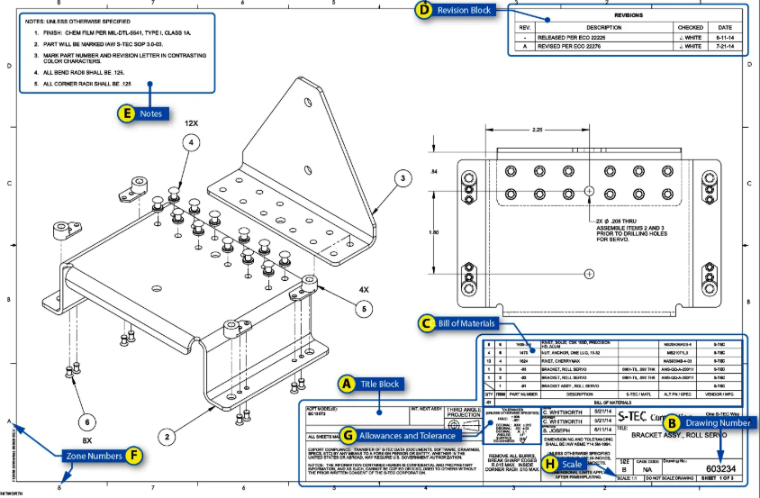

Slide 8
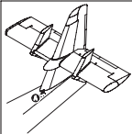
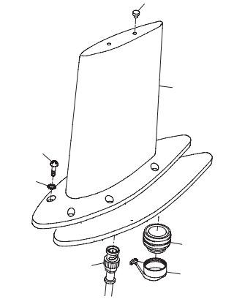
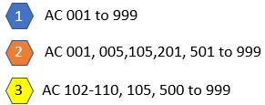

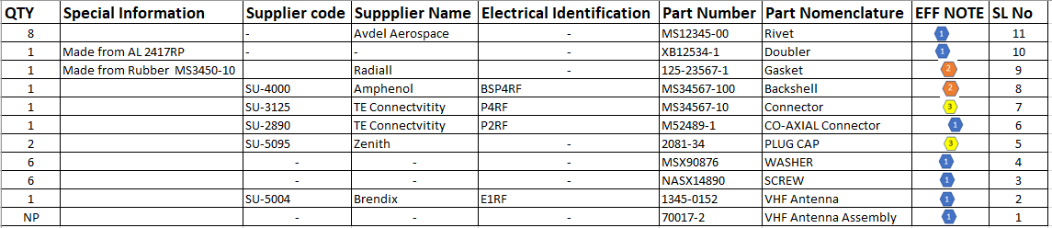
11 4 Place
5
2
Notes
3
9
4
Doubler to be rivetted to structure using Rivet part
7
Rivetting to be done as per the Process Specification document
10
6
11 4 Place
8

Slide 9
Geometric Dimensioning and Tolerancing (GD&T) is a standardized system of symbols and rules used on engineering drawings to define the allowable variation in part geometry, ensuring proper fit, function, and manufacturability. It improves communication between design, production, and inspection teams compared to traditional plus-minus tolerancing.
Key Components of GD&T
Datums: Theoretically perfect points, axes, or planes that act as references to which features are measured.
Feature Control Frame: A "sentence" in the language of GD&T that contains the symbol, tolerance zone, and datum references to define a feature.
Symbols: Specific geometric characteristics (e.g., Position, Flatness, Profile).
Modifiers: Symbols that change the tolerance based on the feature's size, such as Maximum Material Condition (MMC -
) or Least Material Condition (LMC -
Top 5 Key Concepts to Understand
Rule #1 (Envelope Principle): If only a size tolerance is given, the form of the feature is controlled by its boundary—it cannot be perfectly straight or flat if it's at its maximum material condition.
Position Tolerance: Defines the location of a feature (like a hole) relative to a datum, offering a cylindrical tolerance zone instead of a square one.
Datums (A, B, C): Features used as reference points for measuring the rest of the part.
Profile Tolerances: Controls the surface, size, orientation, and location of a shape, often used for complex, non-linear surfaces.
Material Condition Modifiers (
/

Slide 10
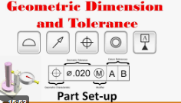
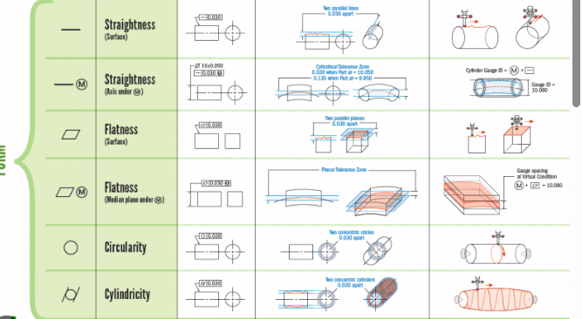
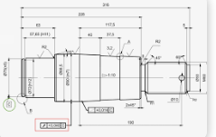

Slide 11
Key Sectors of Aerospace and Defense Industry
Civil Aviation Military Aviation General Aviation (or Specialized AC)
Civil Aviation also known as Commercial aviation involves transportation operations via airway.
Majorly it is identified for transportation of passengers and Cargo.
Different Categories are
Commercial Aircrafts
Business Aircrafts
Cargo Aircrafts
Jumbo Aircrafts
Military aviation is the field of study that deals with aircraft and other flying machines used in warfare. It also includes the national airlift capacity that provides logistical support for forces deployed in war theaters and along fronts. It is often a complex field to study and understand but is of crucial importance for military and civilian operations
Fighters
Bombers
Attack aircraft
Maritime patrol
General Aviation (GA) involves personal flying which now becomes one of the most widely-demanded services.
These include flexibility, safety, and speed. For instance, private plane pilots don’t have to adhere to a strict commercial airline schedule. Their flights can be scheduled as needed
Private AC Flying
Training AC
Air Ambulance
Search and Rescue
Helicopters are included in all 3 Sectors

Slide 12
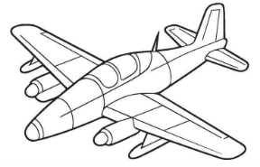
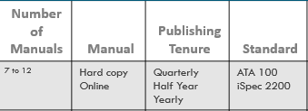
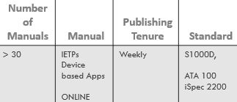
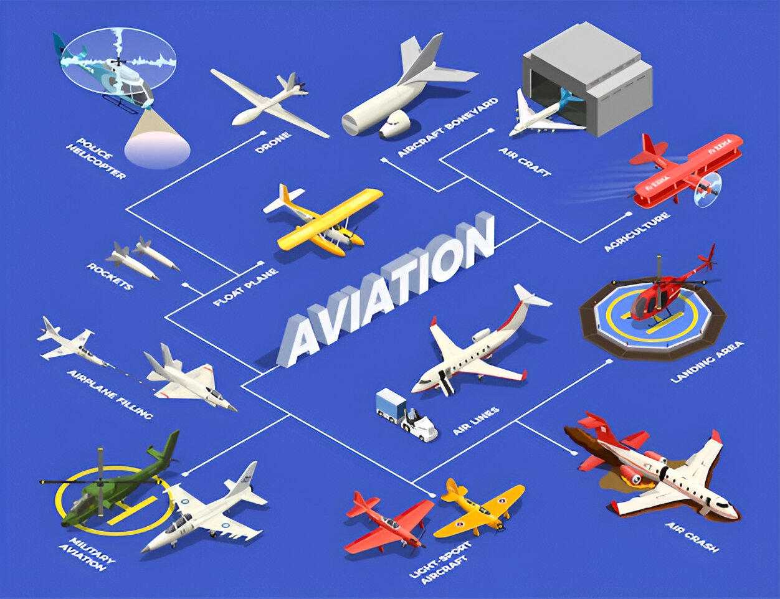

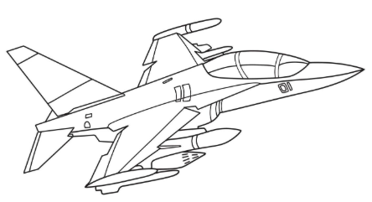
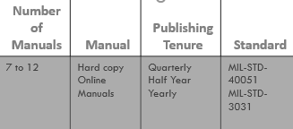
Air Racing and Aerial Advertisement Aircraft
Trainer and Utility
Aircraft
Scientific Research
Experimental Aircrafts
Fire Fighting Aircraft
LIGHT AIRCRAFTS
Air Ambulance
Surveillance Aircrafts
LIGHT AIRCRAFTS
Search and Rescue Aircraft
HEAVY AIRCRAFTS
Civil
Commercial
Aircrafts
Business Aircraft
All type of Military or
Warfare Aircrafts and Helicopters
HEAVY AIRCRAFTS
MILITARY AIRCRAFTS
Cargo Aircraft
MILITARY AIRCRAFTS
Military
Transport
Aircrafts

Slide 13











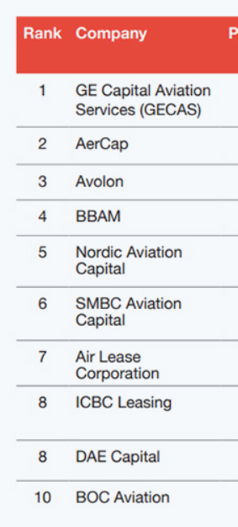

AIRCRAFT MANUFACTURERs OEM
AIRLINE OPERATORs

Slide 14






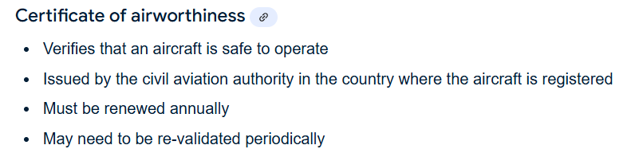
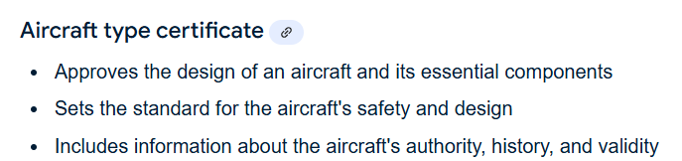
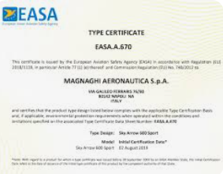
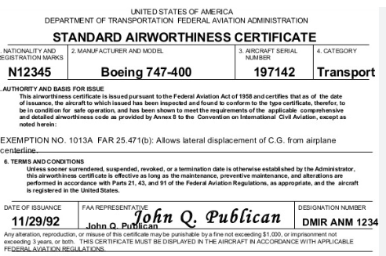
Life Cycle of AIRCRAFTS
Concept and
Market Analysis
Design
Testing,
Prototyping,
And Certification
Production
Delivery and Service
Decommissioning

Slide 15




Delivery and Service
Airbus A320 - total 19000 aircrafts purchased
12000 ++ flying servicing
12500 delivered
7000 + production
Life Cycle of AIRCRAFTS
Aircrafts Manufacturing and Assembly
Flight Testing and Delivery
Aircrafts Flying and Maintenance
Service Phase

Slide 16
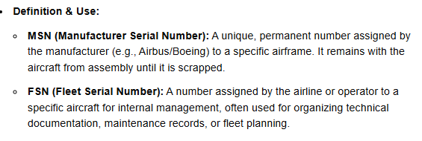
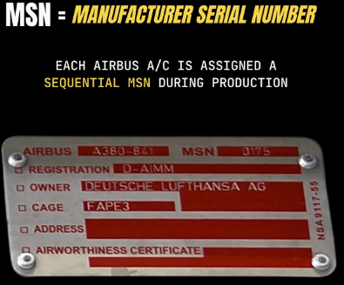
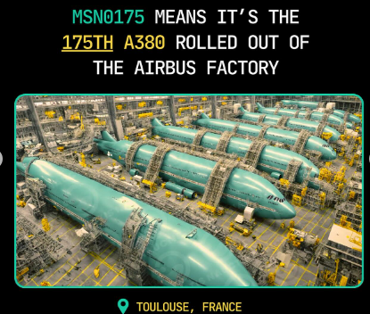
MSN and FSN

Slide 17
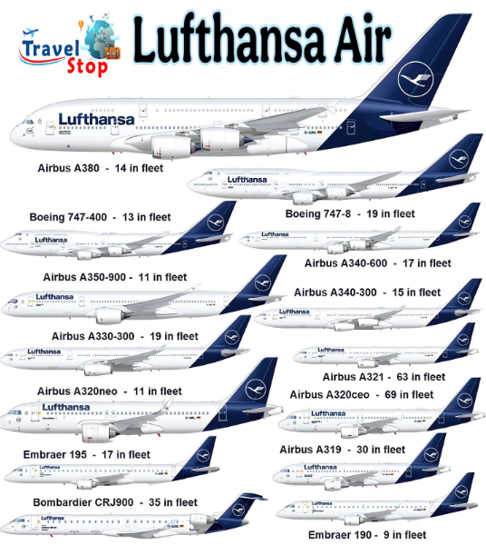


Slide 18

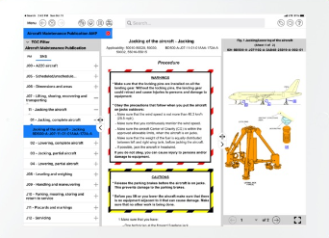

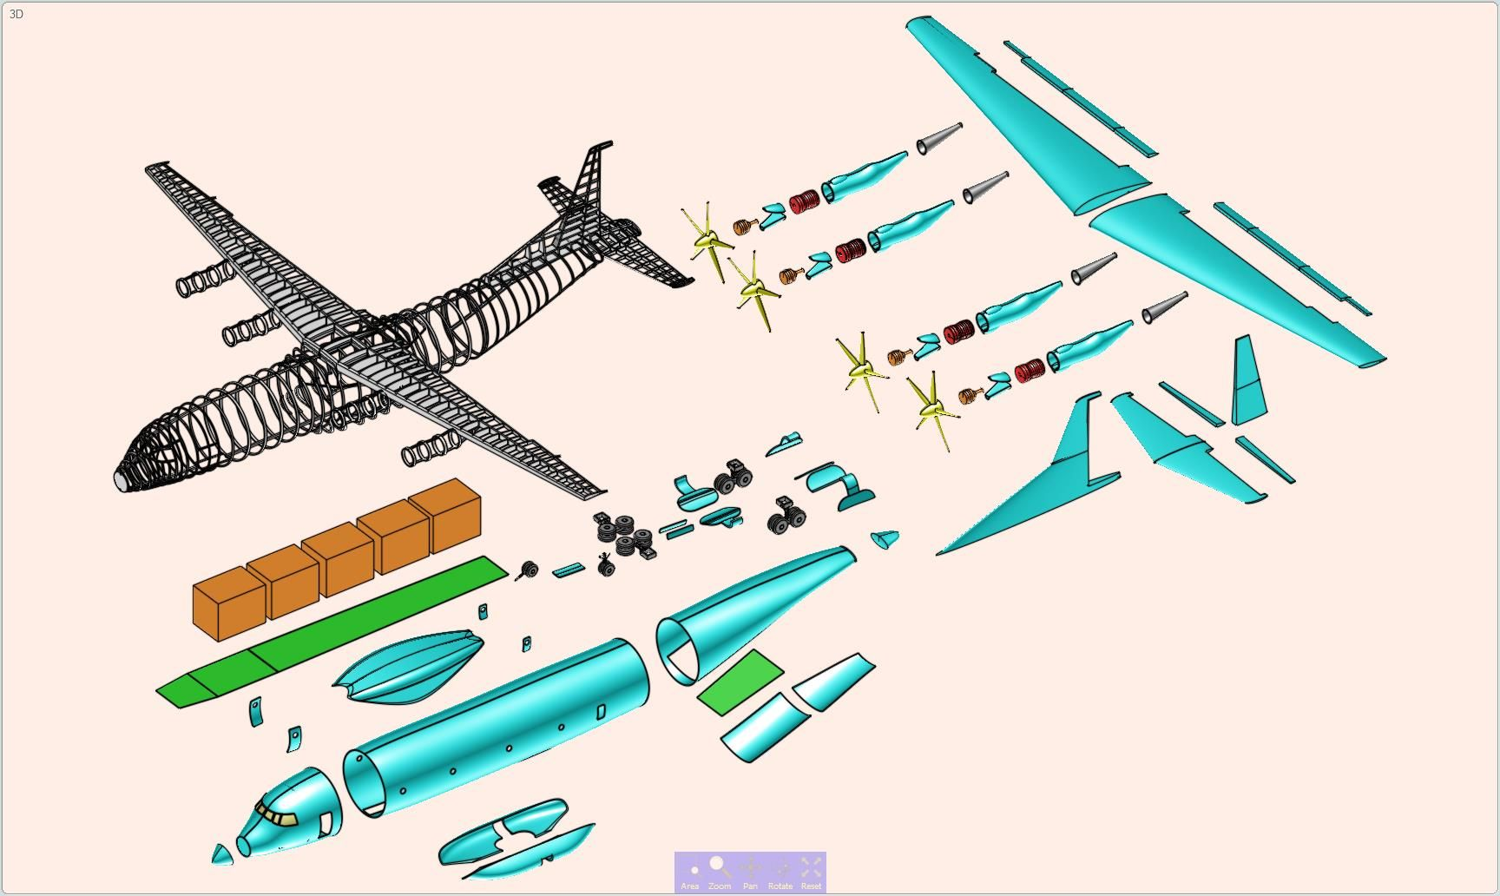





Life Cycle of Aerospace Technical Publication
Concept and
Market Analysis
Design,
Development, and
Assembly
Testing,
Prototyping,
And Certification
Production
Service
Continuous Revisions at different phases
Creation of Manuals
with Engg
High Level Draft
Schema , DTD, DMRL
Finalization Stage for AC Delivery
04
01
02
03

Slide 19


Aircraft Crew and
Maintenance teams

Slide 20






CREW refers to a group of people working together on a common task or in a specific environment. In the context of aviation, a crew typically includes all personnel on board an aircraft who are responsible for its operation and the safety and comfort of its passengers.
Captain: The pilot in command who is ultimately responsible for the safety and operation of the aircraft.
First Officer (Co-pilot): Assists the captain with flying and managing the aircraft
Flight Engineer: Monitors and operates complex systems, but this role is less common in modern
Loadmaster (for cargo flights): Responsible for safely loading, securing, and unloading cargo.
Flight Attendants (Stewards/Stewardesses): Ensure passenger safety and comfort, provide food and beverages, and assist during emergencies.

Slide 21

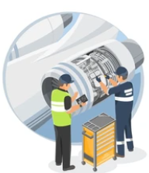
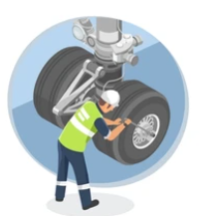




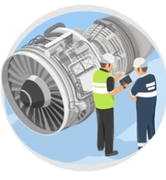

Structural Maintenance Engineers: Focus on the inspection, repair, and overhaul of aircraft structures, such as wings, fuselages, and landing gear
Avionics Technicians: Specialize in maintaining and repairing aircraft electronic systems, including navigation, communication, and radar equipment.
Mechanical Maintenance Engineers: Work on the mechanical systems of the aircraft, including engines, hydraulics, and pneumatic systems
Line Maintenance Technicians: Perform routine maintenance and minor repairs on aircraft between flights, ensuring that the aircraft is ready for its next operation.
Base Maintenance Technicians: Conduct more extensive maintenance tasks, such as major repairs, overhauls, and inspections, typically performed in dedicated maintenance facilities.
Composite Technicians: Specialize in working with composite materials used in modern aircraft construction, performing repairs and inspections on composite structures
Quality Assurance Inspectors: Ensure that all maintenance work meets the required standards and regulations, conducting inspections and audits to verify compliance.
Field Service Engineers :
Perform routine maintenance, diagnose issues, and carry out repairs on aircraft systems and components while they are on the ground run and pre/post flight activities

Slide 22

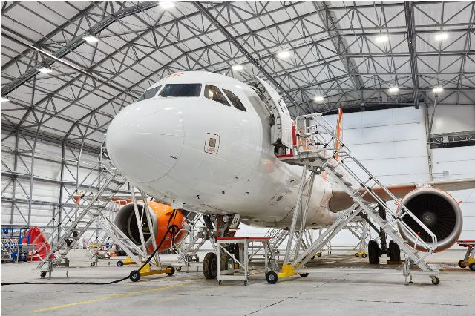
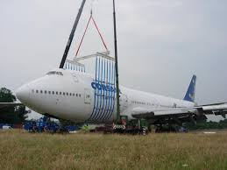
Types of Manuals or Publications
Maintenance Manual
General Manual
Flight Manual
Airplane Flight Manual (AFM)
Flight Crew Operating Manual (FCOM)
Flight Crew Training Manual (FCTM)
Pilot Check List (PCL)
Weight and Balance Manual (WBM)
Aircraft Maintenance Manual (AMM)
Component Maintenance Manual
Illustrated Parts Catalog (IPC)
Fault Isolation Manual (FIM)
Wiring Diagram Manual (WDM)
Aircraft Schematic Manual (ASM)
Aircraft Wiring Manual (AWM)
Aircraft Wiring List (AWL)
Training Manuals
Aircraft Familiarization Training Guide
Aircraft Characteristics Data
Aircraft Recovery Manual (ARM)
Aircraft Manufacturers
Approved – FAA, EASA
High Level Confidential
Flight Manual team
Pilot, Flight Design/System Engineers
Aircraft Manufacturer, LRU OEM and Outsourced Partner
Approved – Internal
Medium Level Confidential
Tech Pub and Engineering Team with AC Technician
Aircraft Manufacturer Approved – Internal
Low Level Confidential
(Few published open Internet)
Tech Pub and Engineering Team with AC Technician

Slide 23






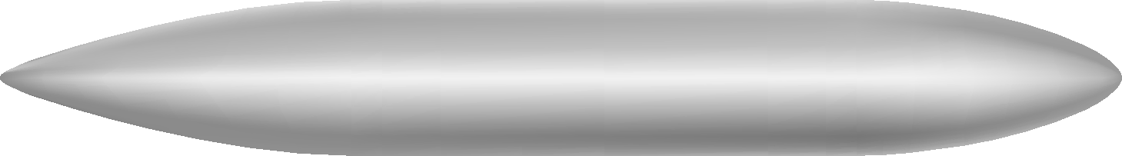







Primary and Secondary Manuals based on Maintenance
Structure Repair Manual
Aircraft Maintenance
Manual
SNAG
RECTIFICATION
Repair Orders
Aircraft Illustrated Parts Catalogue
Non Destructive Testing Manual
Wiring Diagram Manual
Calendar/ Hours based Service
Aircraft Ageing
Illustrated Tools Equipment
Manuals
Fault Isolation Manual
Standard Maintenance
LRU Level
Servicing
System Schematic Manual
Components Maintenance Manual
Wiring List Manual
Latest Parts
Master Minimum
Equipment
List
Service/Production Modification
Standard Maintenance Specification

Slide 24
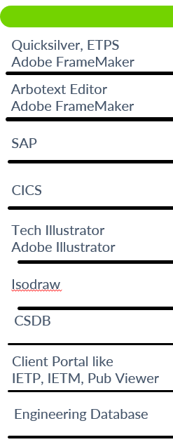
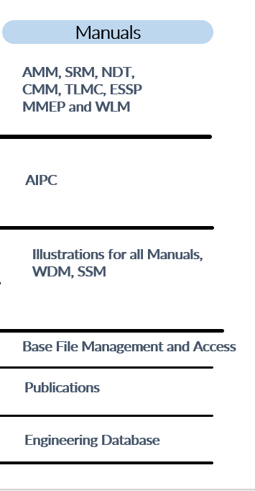


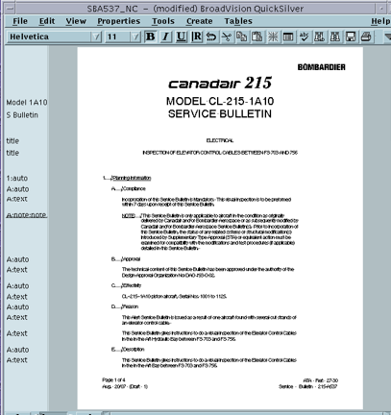
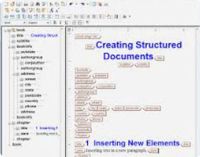



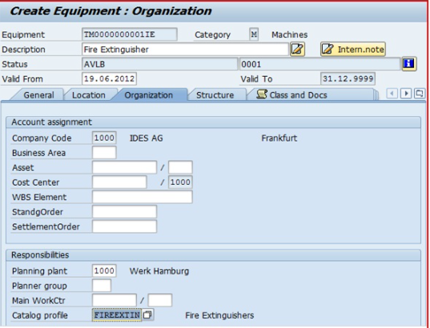
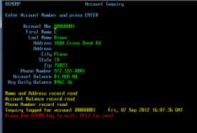


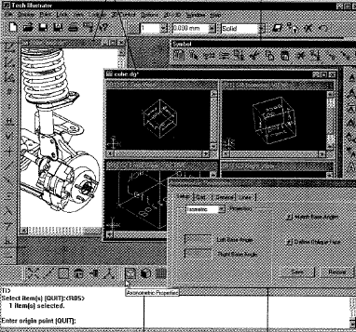
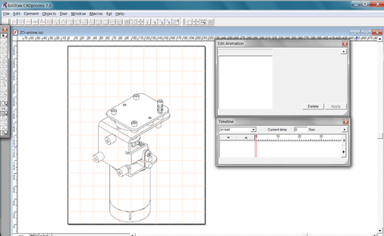


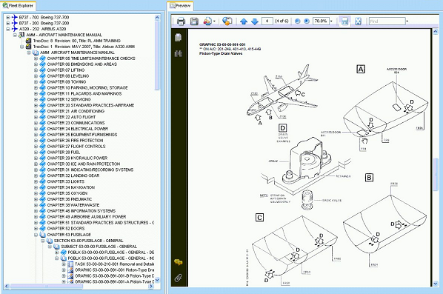

Softwares, Applications – Standards and Manuals
Details
Text based
AND
Tabular
contents
Database
Drawing
Tool
2D & 3D
Platform for S1000D
Client Server based Application
Sometimes installable as well
Client Server based Access portal

Slide 25
AIPC - SAP
AMM – Arbotext or Framemaker
WDM and illustration – Tech Illustrator or Isodraw

Slide 26

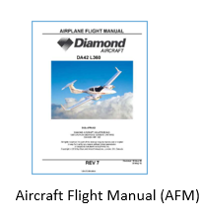
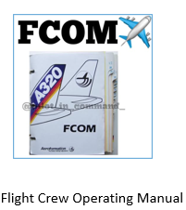
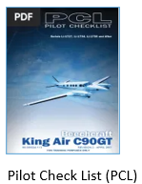
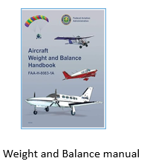
Introduction and Overview of Flight Manuals
Flight manuals are comprehensive documents that provide essential information and instructions for the operation, safety, and performance of aircraft. They are crucial for pilots, Flight Engineers, Flight Attendants, maintenance personnel, and other aviation professionals to ensure safe and efficient flight operations.
These manuals are created, updated by special team consisting of Pilot, Flight Engineer, Systems Engineer, Tech-pub representative. All changes have to be approved by the airworthiness authorities.

Slide 27
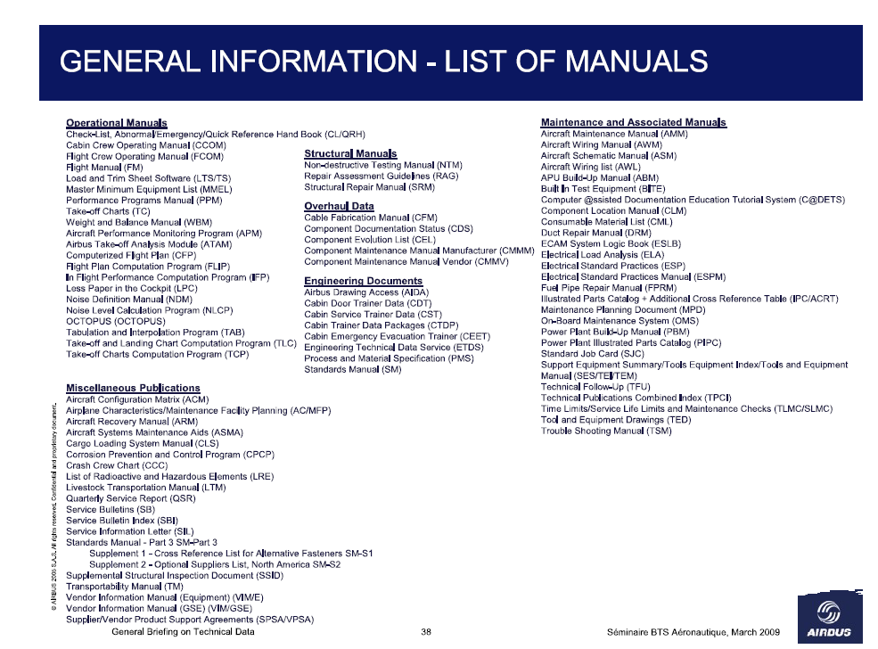

~30 MANUALS
~24 MANUALS
~21 MANUALS
~75 MANUALS

Slide 28
Maintenance Manuals –
These manuals plays a vital role in maintaining the safety, reliability, and performance of aircraft
Aircraft Maintenance Manual (AMM)
Illustrated Parts Catalog (IPC)
Wiring Diagram Manual (WDM)
System Schematic Manual (SSM)
Fault Isolation Manual (FIM)
Structural Repair Manual (SRM)
Component Maintenance Manual (CMM)
Non Destructive Manual(NDTM)
Time Limits Maintenance Check or Standard Maintenance Manual
Standard Practices Manual (SPM)
Engine Maintenance Manual (EMM)
Aircraft Wire List (AWL)
Illustrated Tools and Equipment Manual

Slide 29
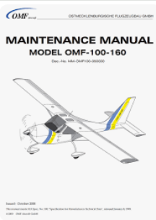
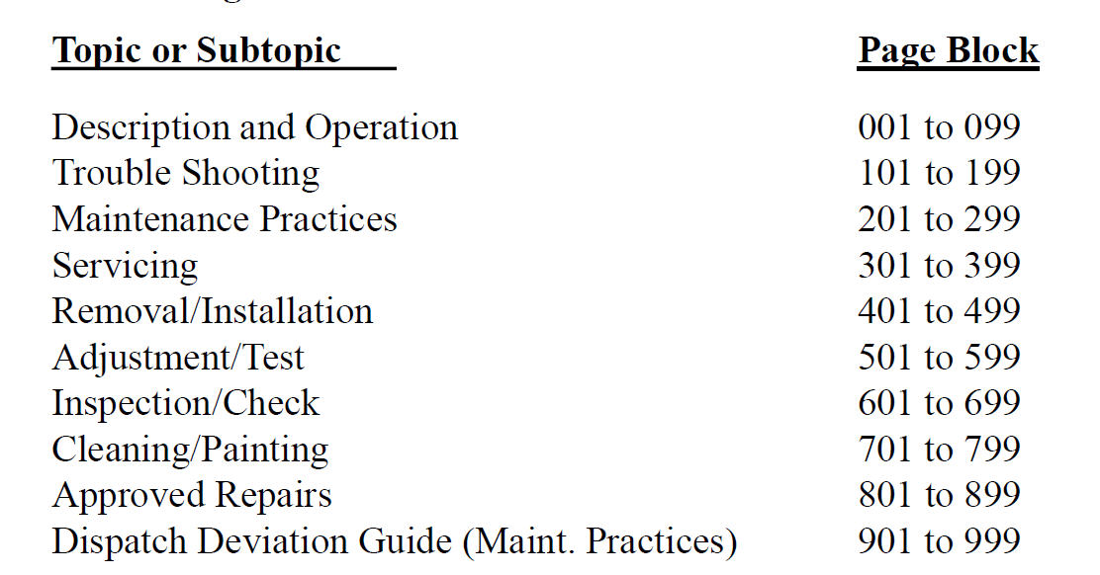
Aircraft Maintenance Manual (AMM) –
The Aircraft Maintenance Manual provides information to enable maintenance personnel to properly
service,
repair,
replace,
adjust,
inspect and
check equipment and systems of the aircraft, normally performed on the ramp or in the
maintenance hangar.

Slide 30
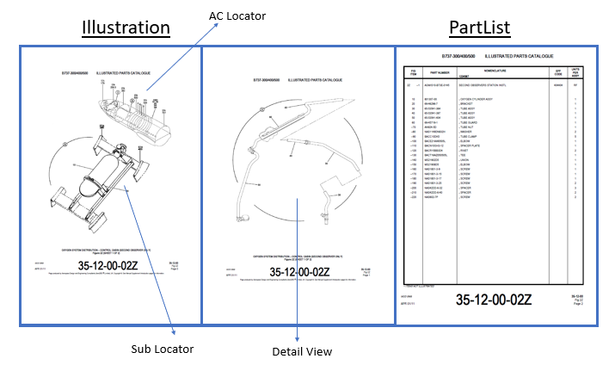
ILLUSTRATED PARTS CATALOG (IPC)
IPC identifies and illustrates all line replaceable parts and units of the aircraft, excluding power plant/nacelle( which are separately covered by the Power Plant Illustrated Parts Catalog (PPIPC)).
It is referred as a companion document to the AMM, as it contains information on all the parts for which maintenance practices are provided.

Slide 31

PartList
Fig
Nomenclature
Item Number
Effectivity
Illustrator/Non-Illustrator
Units Per
Assembly
Part Number
Footer Information
Chap-Sec-Sub Fig Number, Page number , Revision Number and Date

Slide 32

Wiring Diagram Manual (WDM)
  Detailed wiring showing the point-to-point electrical connections between components, such as switches, relays, sensors, lights, and avionics.
  These diagrams illustrate the routing of wires, wire colors, connector types, and pin configurations.

Slide 33



Wiring Pageblock
Schematic Pageblock

Slide 34



Fault Isolation Manual is a manual used by aircraft maintenance technicians to diagnose and isolate faults within an aircraft system.
Flow chart Format
Text Format

Slide 35
Interview Pattern
Basic of Aerodynamics
Lift Principle
Four forces
Parts of Aircraft
Each part high level
Engines -
Basic Components of Engines
4 type of Engines
Explain its difference
Electrical System -
AC and DC supplies
Components
Hydraulic System Block Diagram
Component working on Hydraulic system
Landing Gear types and main components
Communication System -
Different Communication system
Speech communication type
Satellite Communication
Fuel System
Different Fuel tanks
Fuel pressurization
components of fuel system
Navigation System -
ADF
ILS
DME

Slide 36


AIPC PART LIST
PL Table Header Information
Figure Number
Without CSS
Fig 1, 1 A, 2, 2 A..
Item Number
Numbering or parts
Sequenced
Quantity
Effectivity or applicability for
Parts, Assy, Sub Assy
Part Number
Of LRU, Assy, Sub Assy
(as per drawing)
Indenture Level
Relation between successive parts
Parts, Assy, Sub Assy
Name as per drawing

Slide 37






VHF Antenna Installation 300-347779-1
Antenna VHF10-659-1
1E1RV
Screw NAS320-01-00
washer NAS200-01-00
Split washer
NAS110-01-00
Illustration Main Locator
Connector M45442-23A
1P4RV
Gasket
XTS4367-101
Illustration Sub Locator
Adaptor UG3489QW2
1P9RV

Slide 38



Slide 39


Slide 40

Primary or Main Part of the Par list after Installation or Assembly

Slide 41

Attaching parts of the Primary or Main Part to follow

Slide 42


