Slide 1
Aircraft Maintenance Manual (AMM)

Slide 2
Aircraft Maintenance Manual (AMM) –
The Aircraft Maintenance Manual provides information to enable maintenance personnel to properly service, repair, replace, adjust, inspect and check equipment and systems of the aircraft, normally performed on the ramp or in the
maintenance hangar.
The AMM contains information about inspection and maintenance of aircraft structure (except repair).
The AMM also contains the necessary data to cover scheduled maintenance procedures prescribed by the Maintenance Review Board (MRB) report, the Master Minimum Equipment List (MMEL) and the Configuration Deviation List (CDL).
  AMM provides system descriptions and operation as well as instructions and procedures for maintaining the aircraft systems. These procedures are considered “on-wing”
  AMM provides coverage to the level of Line Replaceable Unit (LRU) and does not contain information relating to the overhaul of components or the repair of the aircraft structure
  AMMs are considered Instructions for Continued Airworthiness “ICA” by and identified as such in the A/C Type Certificate

Slide 3
Aircraft Maintenance Manual (AMM) –
  AMM shall not include that information, which is only required for shop based Component and/or Engine Maintenance
  Manufacturers' "Customized" versions of the AMM shall include the system of effectivity identification
  Airframe data shall be customized to show only specific effectivity to the operator’s aircraft tail numbers, registration numbers, etc., as designated by the operator

Slide 4
Aircraft Maintenance Manual (AMM) –
AMM PAGE BLOCKS
General
The Information contained in the AMM has been
divided into two main categories:
Description & Operation
Maintenance Procedures
The Table on the next page gives the various identifications
under which the two types of publications
can be found.
  1- 99 System Description and Operation
  101- 199 Component Location
  201- 299 Maintenance Practices
  301- 399 Servicing
  401- 499 Removal/Installation
  501- 599 Adjustment/Test
  601- 699 Inspection/Check
  701- 799 Cleaning/Painting
  801- 899 Repairs
PRELIMINARY PAGES
Preliminary pages at the beginning of the AMM contain:
Record of Revisions
Service Bulletin List
Deactivation / Reactivation Index
List of Effective Pages

Slide 5
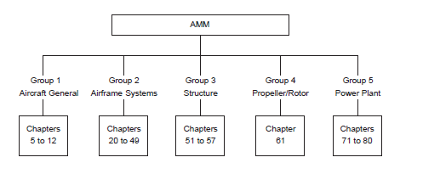
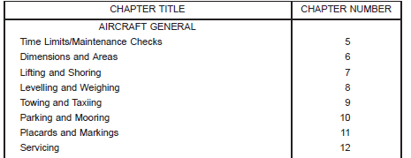
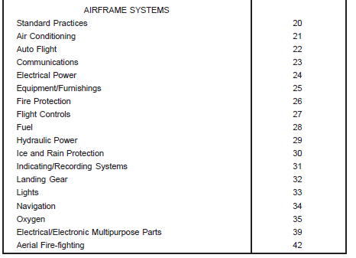
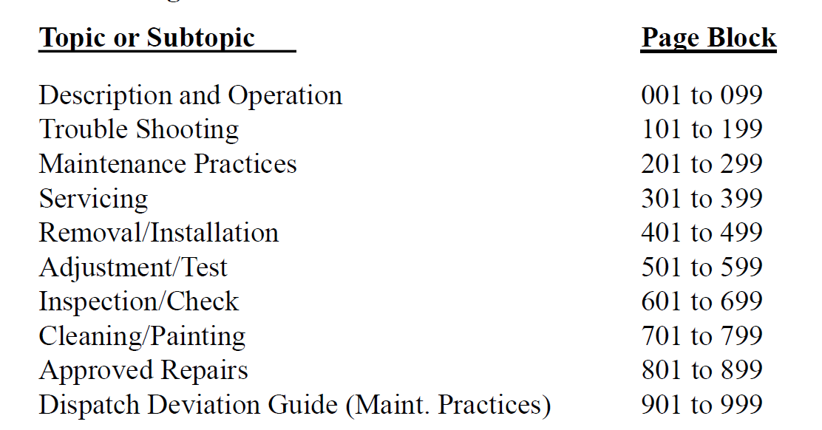
Chapter Numbering
Grouping
Pageblock Numbering

Slide 6
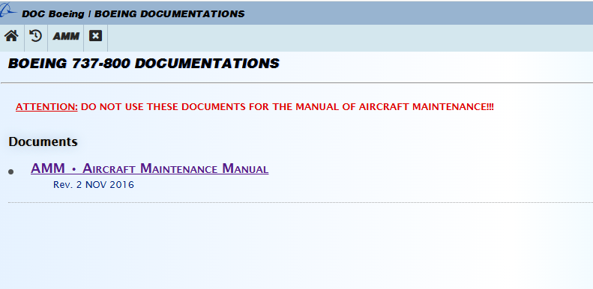
https://wtruib.ru/boeing_737/

Slide 7
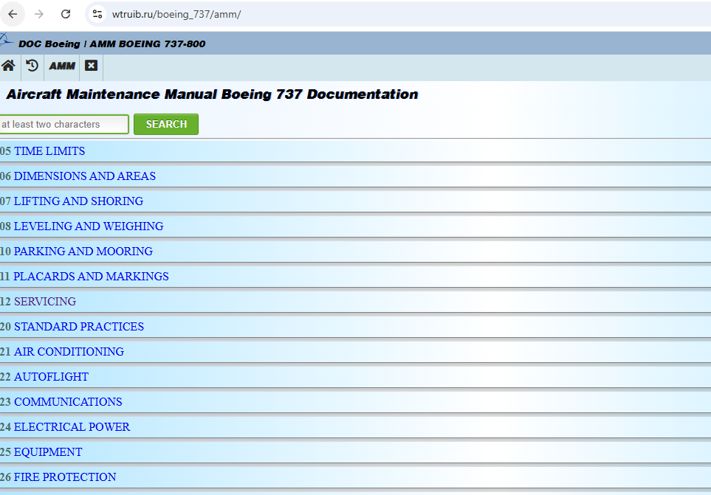

Slide 8
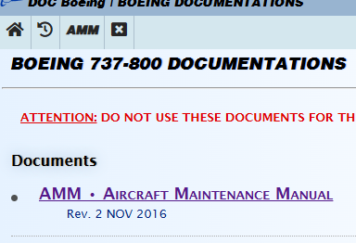

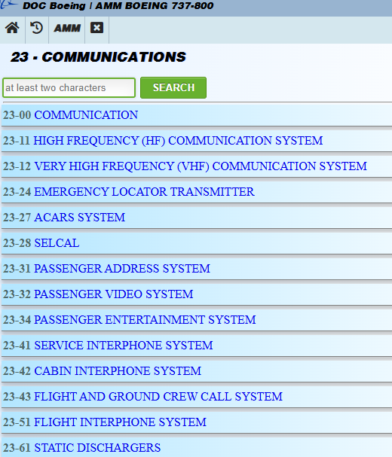
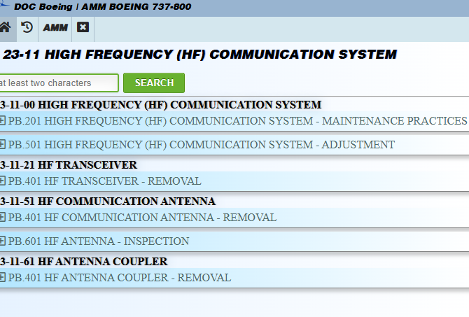

Slide 9
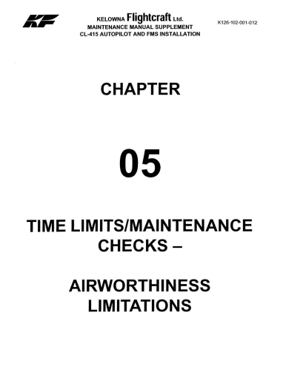
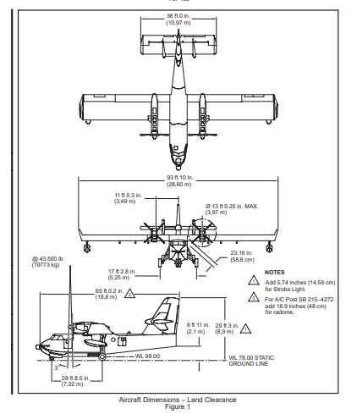
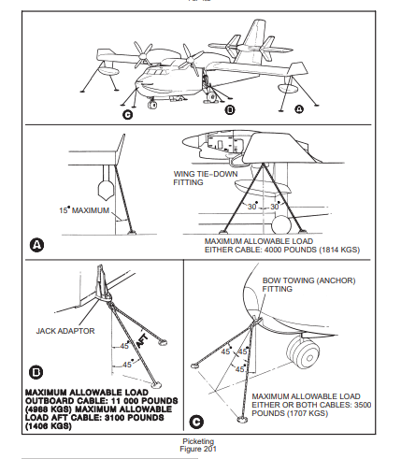
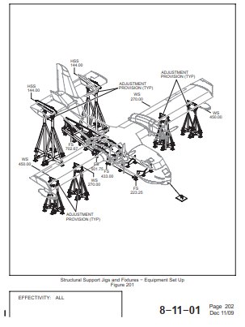
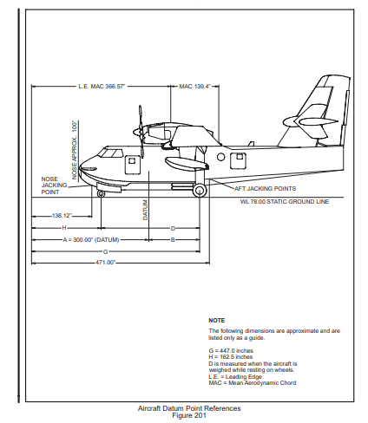
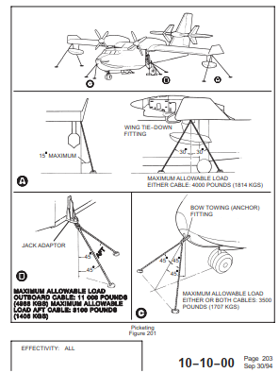
Group 1
Aircraft General
Chapter 5 to 12
Chap 5
Chap 6
Chap 7
Chap 8
Chap 9
Chap 10
GROUND SUPPORT ACTIVITIES
Revisions are not regular like other chapters
Input are also not Engineering Drawings(Drawing structure)
Part Lists will be not in AIPC, instead in GHE Ground Handling Equipment

Slide 10
Group 1
Aircraft General
Chapter 5 to 12
Chap 5
Chap 6
Chap 7
Chap 8
Chap 9
Chap 10

Slide 11
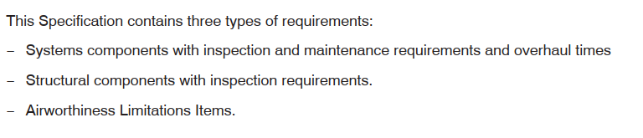
TLMC – Time Limit Maintenance Checks
Some Aircrafts maintain the TLMC as chapter 5 in the AMM.
(**Later it was moved as a separate manual. Reference provided to that manual.)
Aircrafts use even MPD issued / reviewed by Regulatory Authority as alternate to TLMC
Chap 5
TLMC provides the scheduled and unscheduled maintenance activities.

Slide 12
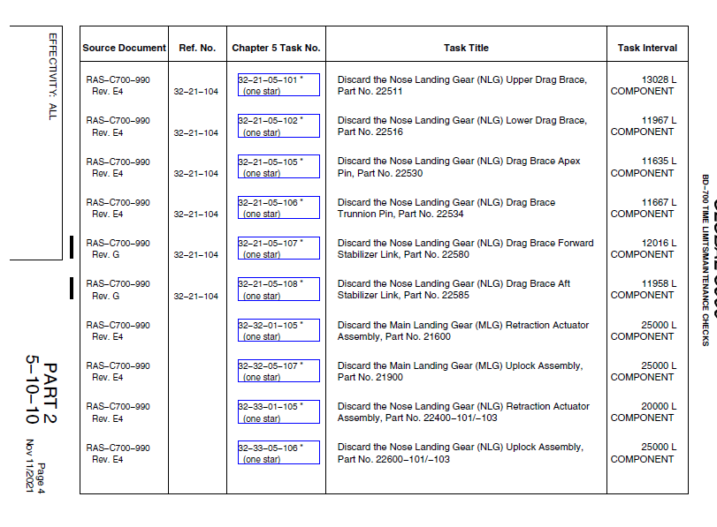
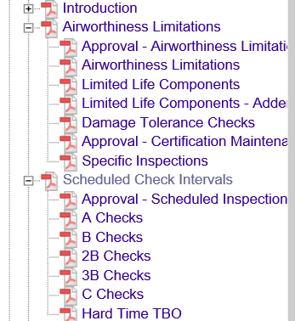
TLMC – Time Limit Maintenance Checks

Slide 13

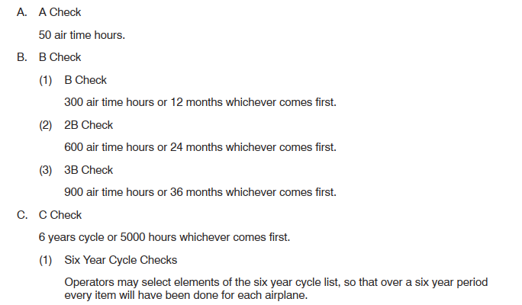
TLMC – Time Limit Maintenance Checks
Chap 5
NOTE – Any changes to the TLMC , will not be driven by Engineering drawings, Production or SBs.
Normally changes or revisions to this chapter will be done by special team and approval
by Regulation Authority

Slide 14
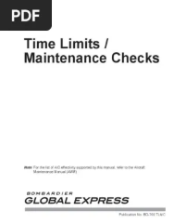
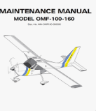
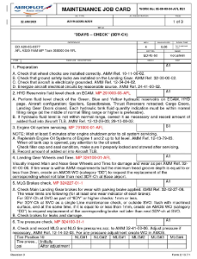
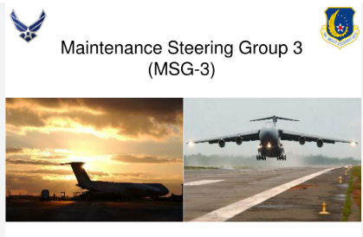
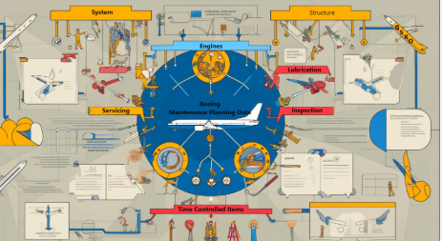
MPD Document

Slide 15
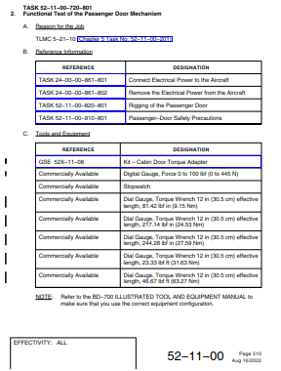
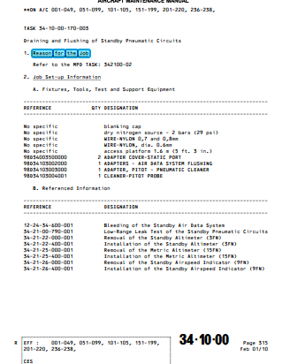
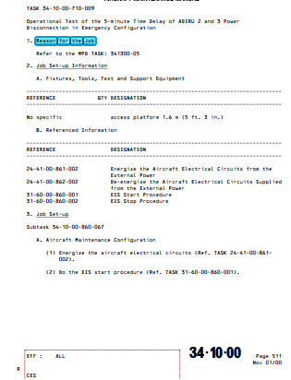
JOB CARD Example

Slide 16
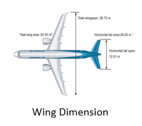
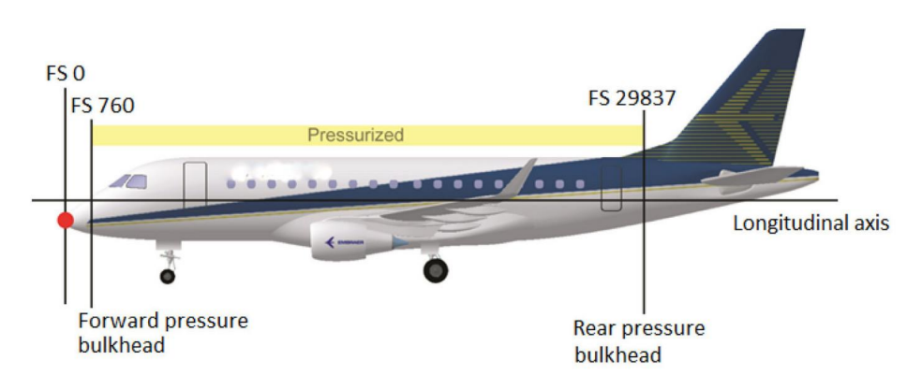
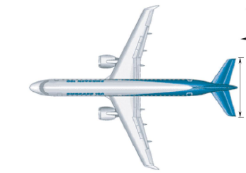
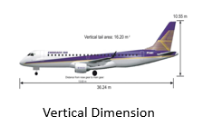
Dimensions and Areas
Dimensions
Chap 6
Fuselage Dimensions
Overall Dimension
Stabilizers Dimensions
Provides Information for Hangar Placement, Towing and Engine run or run way.

Slide 17
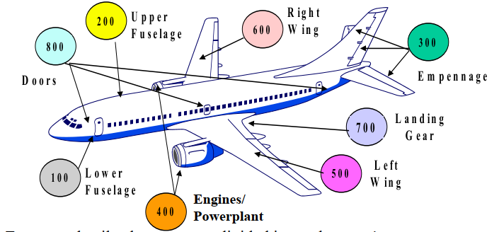
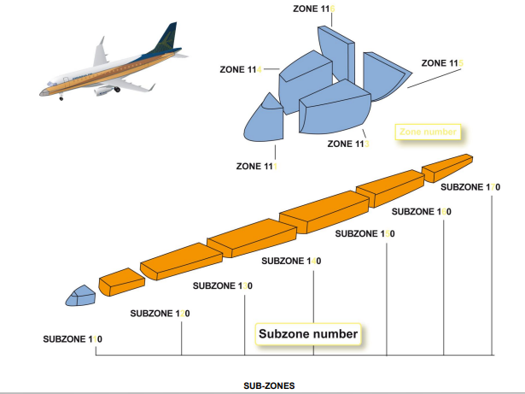
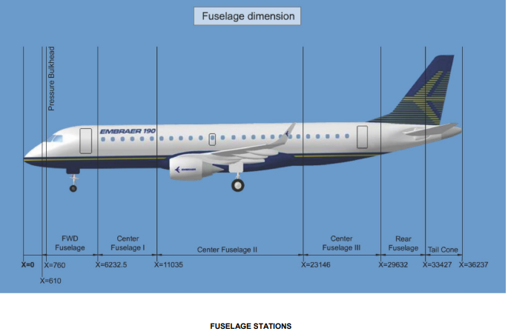
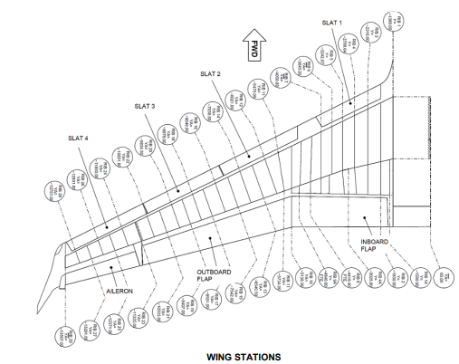
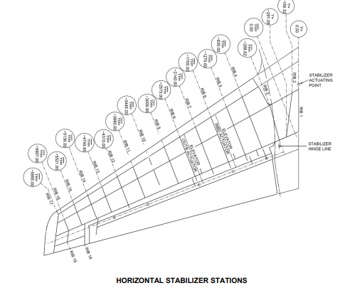
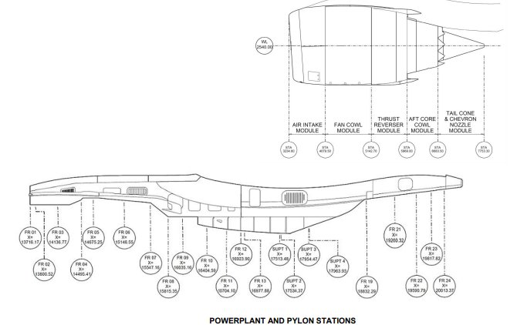
Dimensions and Areas
Areas
SUB-ZONE Numbering
Chap 6
ZONE Numbering

Slide 18
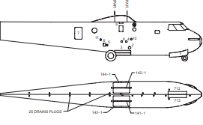
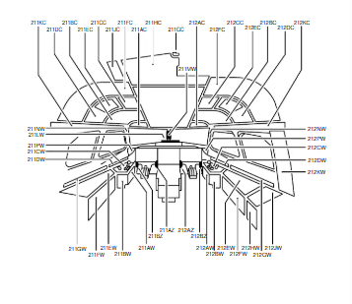
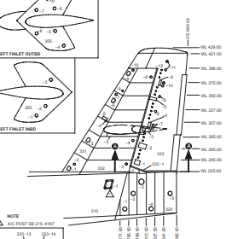
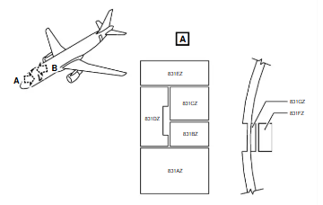
Access to servicing, inspection or maintenance points is provided through quick release or removable doors and panels
Chap 6
FUSELAGE ACCESS PANELS
COCKPIT ACCESS PANELS
DOOR ACCESS PANELS
STABILIZER ACCESS PANELS
These Access Doors and Access Panels are numbered as 5 digit. First three digits represent the zone number and suffix
Numbers which follow the dash , indicate the access door or panel number.
Ex : 250-6 indicates the access panel -6 belongs to the aircraft zone 250

Slide 19
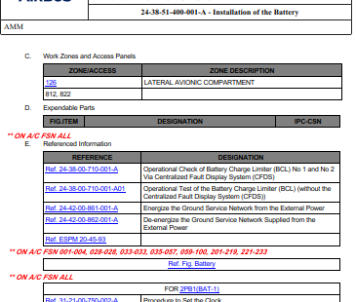
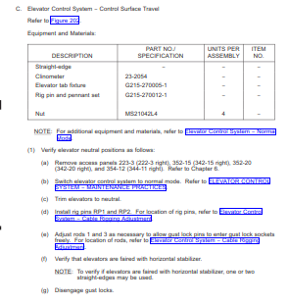
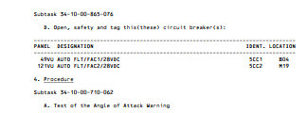

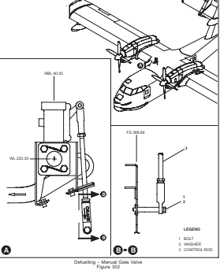
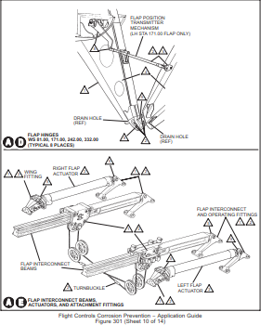
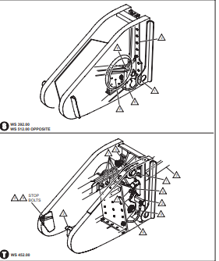
PANEL NUMBERING Example
STATION NUMBERING Example

Slide 20
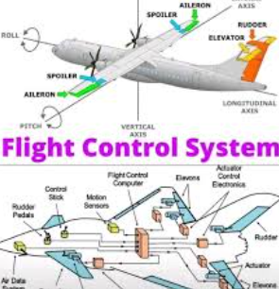

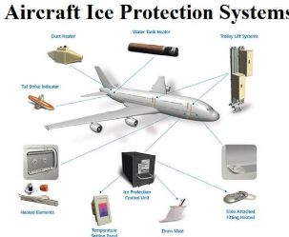
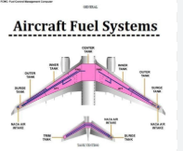


ATA Chapter 12, dedicated to Servicing, provides comprehensive guidelines and procedures for the inspection, maintenance, and servicing of various aircraft systems and components.
Chapter specifically addresses the requirements for servicing and maintaining aircraft systems, ensuring that routine inspections, lubrication, adjustments, and component replacements are conducted in accordance with manufacturer specifications and regulatory standards.
Servicing – Oil , Fluids
Replenishment
Lubrication
Corrosion Prevention

Slide 21
Chapter 20 of an Aircraft Maintenance Manual (AMM) typically covers Standard Practices - Airframe. This chapter provides general information, procedures, and practices applicable to the maintenance and repair of the aircraft's airframe.
Torquing
Tubing – Installation and Repair (Pneumatic, Hydraulic, Pitot static, Air Condition,,,)
Control Cable – Servicing (Flight Controls, )
Electrical Bonding- Installation, Repair, Adjustment/test (Components, Pipes, structure, )
List of Materials needed for Service
EWIS (Electrical Wiring Interconnection System) – Maintenance Practice, Repair, Inspection and Check
Electrical Components – Maintenance Practices
Lubrications

Slide 22
Chapter 20 of an Aircraft Maintenance Manual (AMM) typically covers Standard Practices - Airframe. This chapter provides general information, procedures, and practices applicable to the maintenance and repair of the aircraft's airframe.
Torquing
Tubing – Installation and Repair (Pneumatic, Hydraulic, Pitot static, Air Condition,,,)
Control Cable – Servicing (Flight Controls, )
Electrical Bonding- Installation, Repair, Adjustment/test (Components, Pipes, structure, )
List of Materials needed for Service
EWIS (Electrical Wiring Interconnection System) – Maintenance Practice, Repair, Inspection and Check
Electrical Components – Maintenance Practices
Lubrications

Slide 23



Slide 24












Structure or Hierarchy of Different Pageblock
Aircraft Material and Process Specifications documents are a general documents released by OEMs /Engineering departments.
These documents becomes input for Maintenance Practices, Servicing, Inspection/Check , and Repair Pageblock.

Slide 25
Structure or Hierarchy of Different Pageblock
Pageblock | INPUTS | Applicable | Regular Chapters
System Description and Operation Pageblock (1- 99 ) | Engineering Drawing, SDS, Product Catalogue(Specification) | System , Sub System , Subject Level | ALL Groups and Chapters
Component Location/ Troubleshoot Pageblock (101 - 199 ) | Engineering Drawing | Units Sub System , Subject Level | System Group (chap 20 to 49)
Maintenance Practices Pageblock (201- 299 ) | Engineering Drawing, Process Documents | Basically Process for components, Sub Assemblies | Majorly Chap 20. Rest all Chap VERY few PBs
Servicing Pageblock (301- 399 ) | Engineering Drawing, Process Documents | Basically Process for components, Sub Assemblies | Majorly Chap 12.
Removal/Installation Pageblock (401 - 499 ) | Engineering Drawing, | Units, Components, Parts (structural) | Except AC General Rest all Groups
Adjustment/Test Pageblock (501- 599 ) | Engineering Drawing, FTP, FTER, Product Documents | Units, Sub Assemblies, Components, Parts (structural) | Except AC General Rest all Groups
Inspection/Check Pageblock (601 - 699 ) | Engineering Drawing, | Components, Parts (structural) | Except AC General Rest all Groups
Cleaning/Painting Pageblock (701 - 799 ) | Engineering Drawing, | Components, Parts (structural) | Rear Pageblock – Chap 12,20 and Structural Chap
Repairs Pageblock (801 - 899 ) | Engineering Drawing, Repair Document, | Components, Parts (structural) | Structural Chap

Slide 26
In aircraft maintenance manuals (AMMs), the term **"Description and Operation Page Block"** refers to a specific section or block of pages dedicated to providing detailed descriptions and operational information about a particular system, subsystem, or component of the aircraft. This section is crucial for maintenance personnel to understand how a system functions before performing inspections, troubleshooting, or repairs.
Key Features of the Description and Operation Page Block:
1. **Purpose**:
- To provide a comprehensive explanation of the system or component, including its purpose, functionality, and interaction with other systems.
- To help maintenance personnel understand the system's operation, which is essential for effective troubleshooting and maintenance
2. **Content**:
- **System Overview**: A high-level description of the system or component.
- **Functional Description**: Detailed information on how the system operates, including its operational logic, inputs, outputs, and interfaces.
- **Component Details**: Descriptions of individual parts, their locations, and their roles within the system.
- **Diagrams and Schematics**: Visual aids such as block diagrams, flowcharts, or wiring diagrams to illustrate the system's operation.
- **Operational Scenarios**: Examples of how the system behaves under different conditions (e.g., normal operation, failure modes

Slide 27

D/O Page block Numbering System
ATA Chapter
Aircraft Main System
Aircraft Sub System
Section of a Sub System

Slide 28


D/O Page block Numbering System
ATA Chapter
Aircraft Main System
System Description – High Level with different Sub System in it

Slide 29


D/O Page block Numbering System
ATA Chapter
Aircraft Main System
Aircraft Sub System
Sub-System Description – High Level with different Sections in it

Slide 30




D/O Page block Numbering System
ATA Chapter
Aircraft Main System
Aircraft Sub System
Section of a Sub System
Sub System with
more detailed
information's

Slide 31
Description and Operation Pageblock – Section Level
Sub System Units Locations
With Illustrations as shown
In Assembled Condition
Sub System
Definition
Different Units
Overall Sub System Functions and Features
Sub System details like
Different Units Features
Operations of Sub System

Slide 32



Example - Section Level Units (HF Control Unit)
Control Unit Location, Functions, Modes of Operations, Indication , controls

Slide 33


MECHANICAL SYSTEM SCHEMATIC
ELECTRICAL SYSTEM SCHEMATIC

Slide 34


Maintenance Practices (201 to 299)
This page block is used when :
The content of individual pages is brief and it can be combined into one topic
The procedure does not agree with any specific page block assignment (MMEL Exception contents)
Example – New System introduced with few applicability by SBs
Any Task or subtask that are unique (ex - software loading, Equipment Cooling Practices. A/C Configuration)

Slide 35



Examples for Maintenance Practices

Slide 36


Servicing
Servicing procedures can be restorative or normal in nature.
(a) Restorative (301 to 399)
Chapter 12 contains scheduled and unscheduled servicing applicable to the whole aircraft. Included in this chapter are the replenishment of items such as: fuel, oil, hydraulic fluid, water, tire pressure, etc.
(b) Normal (301 to 399)
Servicing which is necessary to complete other maintenance tasks is found in related chapters. Tasks such as filling and draining of a component.

Slide 37



Servicing ispec2200 Structure
Task Number for Servicing
Reason for the Job
Job Setup Information
Consumable Material List
Expendables Parts
Referenced Information
Job Setup
Subask Number for setup
(Access panels, CBs,..)
Main Servicing Procedure
Close out (Return to Service)
Closing of Panels, CBs.
Reverse of Job setup

Slide 38


Removal/Installation (401 to 499)
(a) Removal/Installation procedures have two independent tasks: one for the removal and one for the installation.
(b) The removal/installation are given for the components identified as line replaceable units, Structural Parts and Sub Assemblies
(c) Removal and Installation pageblocks helpful to operators during fault diagnosis, modifications, upgradations and repairs (gives access to other parts when is removed)

Slide 39











Points to be considered while creating or updating Removal and Installation Pageblocks
Removal and Installation pageblocks are normally for the Line replaceable units.
*** Line Replaceable Units (LRUs) are modular components in an aircraft that are designed to be
quickly and easily replaced at the line maintenance level, typically without requiring extensive disassembly or specialized tools. These are ON-wing removable parts, components or units. LRUs generally are
Instrument and Electrical
Avionics
Interiors

Slide 40






Points to be considered while creating or updating Removal and Installation Pageblocks
Fuels System
Tanks, Cells, Valve, Pumps (shut off, pressure relief,,), Probes, Indicators
Engine/Powerplant –
Propeller, Engine, Engine Cowls, Valves, Pumps..
Flight Controls

Slide 41


Points to be considered while creating or updating Removal and Installation Pageblocks
If wheels or wheel brakes to be replaced, can the whole Landing gear assembly sent to the respective manufacturer as its part
Of CMM?
OEMs, Operators and Regulatory authorities can define units/parts that are actually supposed to be part of CMM, can be
Made On-wing or On-aircraft maintainable (ie part of AMM)

Slide 42
Points to be considered while creating or updating Removal and Installation Pageblocks
Note – No R/Is in the Aircraft General category (chap 5 to 11) as they are mainly ground support activities or information's
How are the R/Is determined – Fault Analysis,
Snag Rectification process,
Life limit components,
MEG3 Analysis recommendations
Which Parts not in R/I ?????
Which Parts not in R/Is - Normally the OEMs, MS Group and Regulatory authorities define the tasks.
Few thumb rules like Permanent Fastened Parts,
Engine turbine blades, discs, or bearings (handled via Engine Manual or Overhaul Manual).
Wiring harnesses (often in Wiring Manual (AWM)).
Composite repairs (handled via Structural Repair Manual (SRM)).
Interior furnishings (covered in Cabin Maintenance Manual (CMM)).
Input Documents are Engineering Drawings, Service Bulletins, Process and Material Specifications (structural R/Is)

Slide 43





Points to be considered while creating or updating Removal and Installation Pageblocks (all this applicable to all PBs except D/O)
Tasks and Sub-Tasks
SUB TASK 1
SUB TASK 2
SUB TASK 3

Slide 44





Points to be considered while creating or updating Removal and Installation Pageblocks
Removal and Installation – Format
PROCEDURE ILLUSTRATIONS PROCEDURE

Slide 45
Points to be considered while creating or updating Removal and Installation Pageblocks
Removal and Installation – Structure
Task Number for Removal
Task Name
Reason for the Job
Job Setup Information
Consumable Material List
Expendables Parts
Referenced Information
Job Setup
Subtask Number for setup
(Access panels, CBs,..)
Removal Procedure
Task Number for Installation
Task Name
Reason for the Job
Job Setup Information
Consumable Material List
Expendables Parts
Referenced Information
Job Setup
Subtask Number for setup
(Access panels, CBs,..)
Installation Procedure
Close out (Return to Service)
Closing of Panels, CBs.
Reverse of Job setup
Removal and Installation are each one task
respectively
Always Removal task will be first
Between both tasks, illustration will be there
Illustration will be always common for both tasks
Illustration will be shown in dis-assembled view
Removal Procedures will not have closeout
In Case of LH/RH , No 1 and No 2, only one is
depicted
This example is of iSpec Standard.
ATA and S1000D examples will be detailed during Tech pub Standards class

Slide 46



Points to be considered while creating or updating Removal and Installation Pageblocks
Reason for the JOB :
It provides the maintenance technician with the context and background information about why a particular maintenance task is being performed. This helps the technician understand the importance and relevance of the task.
This is not a mandatory field, depends on OEMs decisions.
Few of the Reason for the job are as below –
MMEL Reference
Access Purpose
MPD Reference
Safety Purpose

Slide 47





Unscheduled activities or chap 5
AC General chapters like parking, toeing,

Slide 48
Points to be considered while creating or updating Removal and Installation Pageblocks
Job Setup Information
Consumable Material List
Expendables Parts
Referenced Information
** Tools and Equipment
** Safety Precautions and Access Information
Consumable Material List of materials and supplies that are used during maintenance tasks but are not permanently installed on the aircraft.
These materials are typically consumed or used up during the maintenance process and need to be replenished regularly.
The list ensures that technicians have the necessary materials to perform tasks efficiently and in compliance with the manufacturer's specifications.

Slide 49





Slide 50



Tools and Equipment
Lists the specific tools, equipment and Fixtures required to perform the task.
In cases of Tools and Equipment Manual separate, reference of that manual will be provided in Reference Information
Contain standard tools as well commercially available tools and customized once
Safety Precautions and Access Requirements
Outlines safety measures to protect personnel and the aircraft.
Specifies how to access the area or component being worked on (e.g., removing panels, opening compartments)

Slide 51


Points to be considered while creating or updating Removal and Installation Pageblocks
Referenced Information
Referenced Information" refers to cross-referenced within the manual to provide further details, instructions, or context for a specific task or procedure. This information is essential for ensuring that maintenance personnel have access to all necessary resources to perform their work correctly, safely, and in compliance with regulatory requirements.

Slide 52


Points to be considered while creating or updating Removal and Installation Pageblocks
Job Setup
Caution, Warning and Notes
Warnings
Purpose: Indicates a potentially hazardous situation in serious injury or loss of life if not followed correctly. It is the most critical alert and demands immediate attention.
Cautions
Purpose: Indicates a potentially hazardous situation that, if not avoided, could result in minor or moderate injury, or damage to equipment or the aircraft.
Notes
Purpose: Provides additional information, clarification, tips or best practices that are not directly related to safety but are important for the successful completion of the task.

Slide 53

Points to be considered while creating or updating Removal and Installation Pageblocks
Job Setup
Caution, Warning and Notes will be applicable to any part of the maintenance task .
It can be for complete pageblocks, task, sub-task, or an particular step.
All three are to be placed before the task for which this will be applicable.
In case all 3 are applicable , order of priority are as below,
  Warning,
  Caution and
  Notes

Slide 54
Points to be considered while creating or updating Removal and Installation Pageblocks
Job Setup
  Job setup provides the steps required before the actual procedure named in the task that can be performed. These instructions can include:
    De-activate the aircraft (Safety- Electrical, Hydraulic, Landing Gears, Engine..etc )
    Set up work stands (Preparation)
    Open access panels (Access Provisions)
    Set the aircraft to a necessary configuration such as extended flaps
    Open and tag circuit breakers
Sl.No | Job Setup | Details
1 | De-activate the aircraft | Standard Practice Pageblock , Process Document/drawing, Notes in Engineering Drawing and related pageblock information's
2 | Set up work stands
3 | Open/Close access panels | Related Zones from Engineering Drawing then Chapter 06 referencing. OR from Engineering Drawing details
4 | Set the aircraft to a necessary configuration | Process Document/drawing, Notes in Engineering Drawing and related pageblock information's
5 | Open and tag circuit breakers | Referring the related Wiring Drawing or Wiring Manuals

Slide 55






Procedure
Each Procedure will be followed with a task or sub-task number and naming
First step in the procedure is the reference to the illustration or figure number.
The procedure steps usually presented in a numbered or bullet-point format.
Each step is clear, concise, and includes all relevant details to guide the technician through the task.
Parts, Units or components in the illustrations are identified with a item number.
These are called in the procedure with its description or names followed by item numbering
Each Item will be shown with quantity if its more than one

Slide 56


Procedure - Other KEY POINTS
Procedural steps to follow Simplified Technical English (STE). In case of S1000D, ASD-STE standard to be followed.
Each Aircraft Program will have its own Authoring and illustration style-guides.
In case of attaching parts, same step to cover removal or installation for all the parts together
Example – Install the screw (X),the washers(X) and the bolt(X) and tighten them.

Slide 57


Procedure - Other KEY POINTS
All Electrical Connectors, Plugs, Tubes and Pipelines after removal to be capped for safety and dust accumulation prevention.
The Cap for the same will be part of the consumable table.

Slide 58



Procedure - Other KEY POINTS
All the Washers, Seals, and rubber materials like O-rings, Gaskets are to be inspected after removal. In case if it is worn or damaged, to be replaced.
Details of these Washers, Seals and rubber materials to be available in the expandable table or part of the referenced information AIPC pageblocks.
NOTE - Will be discarded directly or after inspecting the expendables based on engineering recommendations.

Slide 59



NOTE – In some cases, this expendables details will be part of Caution before the task

Slide 60



Procedure - Other KEY POINTS
Effectivity Split or range to be provided at the starting of the task, sub-task or at he same steps as applicable. Few cases Effectivity split will have to be shown in illustration for Fit or Form changes.

Slide 61

Procedure - Other KEY POINTS
Installation sequence to be reverse of the removal sequence.

Slide 62



Procedure - Other KEY POINTS
Installation sequence to be reverse of the removal sequence.

Slide 63
CLOSE OUT
Close out is opposite to the Job setup process , and is also called Return to service action.
Close out normally brings backs the aircraft to its flying or service status.
It Includes activities like
Inspection of expendables and replacing
Removing Test Kits, Jigs, Stands..
Deenergize External Power Supply
Circuit Breakers Closing
Access Panels Closing
Software Loading
Performing Servicing activities like Bonding, Lubrication, .
Performing Adjustment/Test
All Job setup activities can be redone in reverse order along-with other specified activities.
Notes
Only Installation task will have the closeout , not the Removal task.

Slide 64


AUTHORING OUTLINES (STRUCTURED AUTHORING)
Authoring Hierarchy –
1.
A.
(1).
(a).
1.
a.

Slide 65

AUTHORING OUTLINES (STRUCTURED AUTHORING)
Components or Elements
Paragraph – Allows Para content as per Component Hierarchy
Header – Allows Headers of Task or sub Task
Task or sub task with links
Tables – Different types of Table insertions allowed
Figure Number with links(Refer to Fig)
Listings (Ordered and Unordered)

Slide 66

AUTHORING OUTLINES (STRUCTURED AUTHORING)
Components or Elements
Warning, Caution and Notes

Slide 67
Structure or Hierarchy of Different Pageblock
Pageblock | INPUTS | Applicable | Regular Chapters
System Description and Operation Pageblock (1- 99 ) | Engineering Drawing, SDS, Product Catalogue(Specification) | System , Sub System , Subject Level | ALL Groups and Chapters
Component Location/ Troubleshoot Pageblock (101 - 199 ) | Engineering Drawing | Units Sub System , Subject Level | System Group (chap 20 to 49)
Maintenance Practices Pageblock (201- 299 ) | Engineering Drawing, Process Documents | Basically Process for components, Sub Assemblies | Majorly Chap 20. Rest all Chap VERY few PBs
Servicing Pageblock (301- 399 ) | Engineering Drawing, Process Documents | Basically Process for components, Sub Assemblies | Majorly Chap 12.
Removal/Installation Pageblock (401 - 499 ) | Engineering Drawing, | Units, Components, Parts (structural) | Except AC General Rest all Groups
Adjustment/Test Pageblock (501- 599 ) | Engineering Drawing, FTP, FTER, Product Documents | Units, Sub Assemblies, Components, Parts (structural) | Except AC General Rest all Groups
Inspection/Check Pageblock (601 - 699 ) | Engineering Drawing, | Components, Parts (structural) | Except AC General Rest all Groups
Cleaning/Painting Pageblock (701 - 799 ) | Engineering Drawing, | Components, Parts (structural) | Rear Pageblock – Chap 12,20 and Structural Chap
Repairs Pageblock (801 - 899 ) | Engineering Drawing, Repair Document, | Components, Parts (structural) | Structural Chap

Slide 68




Activation and Deactivation (401 to 499) -
Deactivation – Procedure describes the procedure to be performed to allow flight operations with a system or a part of system, failed according the MMEL and CDL requirements
Reactivation – Procedure describes the maintenance operation to be required to restore the system to normal
Operation after removal or deactivation of the faulty component or system.

Slide 69

Adjustment/Test (501 to 599) - There are three types of tests: operational, functional, and system.
Operational Test -
Procedure required to ascertain only that a system or unit is operable.
These tests should require no special equipment or facilities other than that installed on the aircraft.
Example – Built In Test Equipment's , HF or VHF Communication Checks

Slide 70



Functional Test -
Procedure required to ascertain only that a system or unit is functioning in all aspects in accordance with minimum acceptable system or unit design specifications.
These tests may require supplemental ground support equipment and should be more specific and detailed than an operational test
Example – Flight control surfaces rigging checks

Slide 71



Adjustment/Test (501 to 599) System Test
System Test -
Procedure containing all adjustment specifications and tolerances required to maintain system and or unit performance at maximum efficiency and design specifications.
It shall be self-contained and may duplicate other tests.
Example - Hydraulic system pressure and flow.

Slide 74


Inspection/Check (601 to 699)
(a) This page block contains information and instructions to inspect or perform a check of:
System
Component
Area (zone)
Connected parts.

Slide 75


Cleaning/Painting (701 to 799)
This page block gives the necessary procedures to clean and/or paint a part or area of the aircraft.

Slide 76


Repairs (801 to 899)
This page block gives all approved repair procedures for the aircraft. It does not include
those repairs contained in the Component Maintenance Manual and the Structural
Repair Manual.

Slide 77


Revision Changes –
Revision Bar
Ripple Bar
Deletion Bar

Slide 78
FRONT MATTER –
Table of Contents
List of Effectivities
List of Effective Pages
List of Service Bulletin Incorporated
Temporary Revision Incorporated
Record of Revision
Permanent Record

Slide 79





Slide 80


Slide 81





