Slide 1
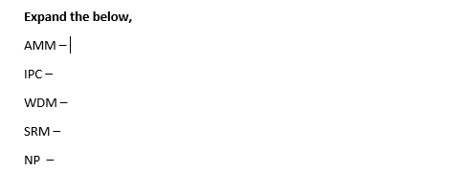
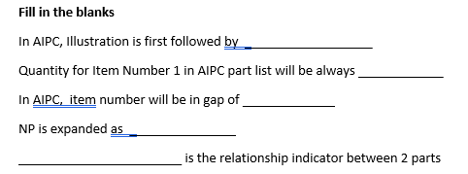

Slide 2

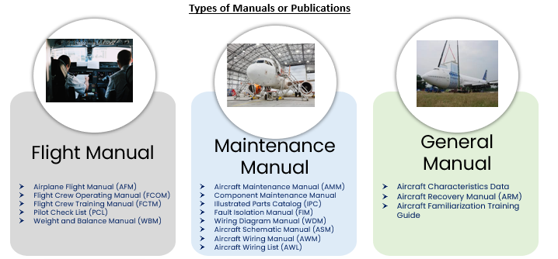

Slide 3

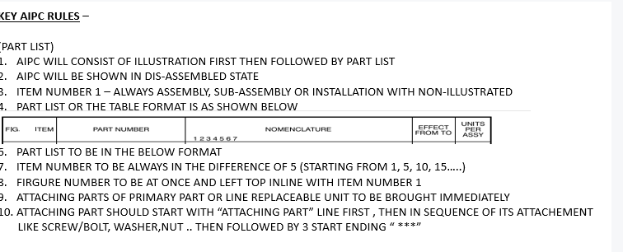

Slide 4
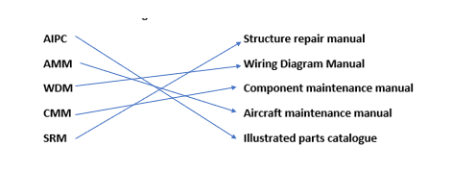
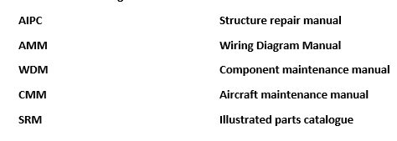
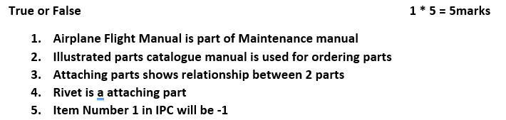


Slide 5
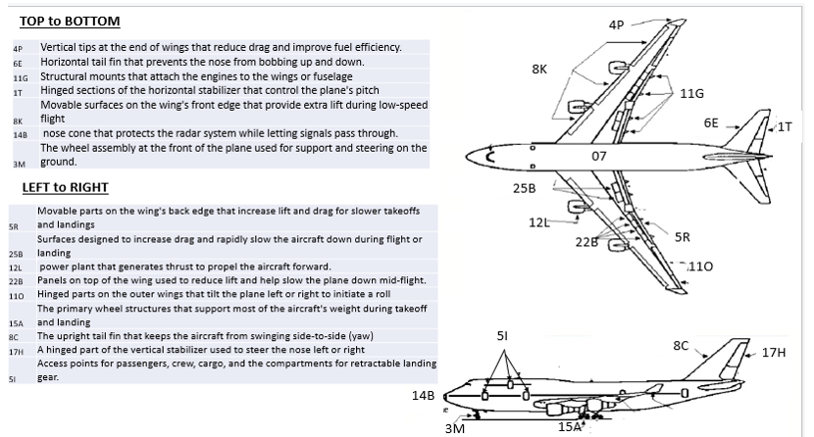

Slide 6
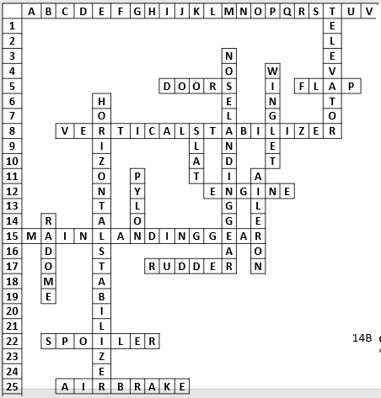
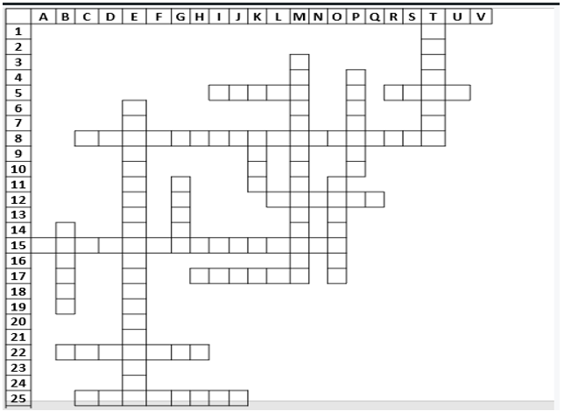

Slide 7
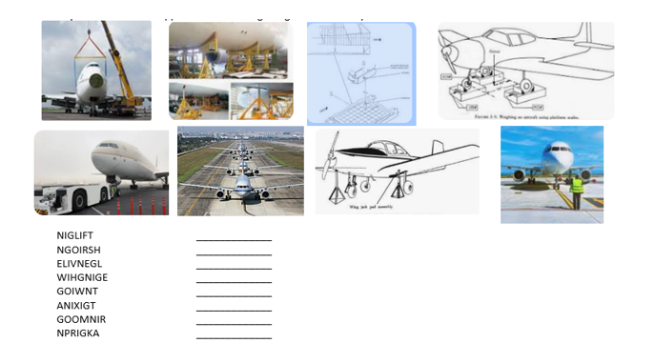


Slide 8
AIRCRAFT MAINTENANCE PUBLICATION OR MANUAL
AMP - AMM

Slide 9
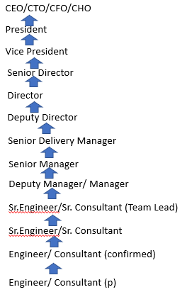
TECHNICAL SWs COMMUNICATION LEADERSHIP PRESENTATION CLIENT FINANCE SALES
Time MGMT

Slide 10
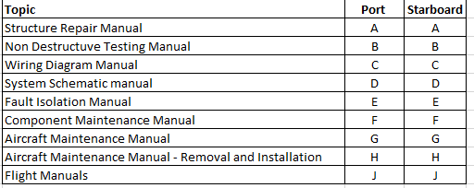

Slide 11
Team 1 | AMM | Description and operation
Team 2 | AMM | Maintenance Practices
Team 3 | AMM | Servicing
Team 4 | AMM | Removal/Installation
Team 5 | AMM | Adjustment/Test
Team 6 | AMM | Inspection/Check
Team 7 | AMM | Cleaning/Painting
Team 8 | AMM | Repairs
Team 9 | FCOM | Flight Crew Operating Manual FCOM
Team 10 | SRM | Structure Repair Manual
Team 11 | WDM | Wiring Diagram Manual
Team 12 | FIM | Fault Isolation Manual
Team 13 | NDT | Non Destructuve Manual
Team 14 | CMM | Component Maintenance Manual
Team 15 | AFM | Airplane Flight Manual

Slide 12
Presentation Content – ( 25min to prepare and 2-3 min to present )
1 – Definition of Manual or Purpose of Manual
2 – Content of Manual about different information on it (Generic)
3 – Explain any one example with Screenshot or picture of the manual
Presentation –
Give Introduction of team members and Name (Can give any Aircraft related name)
Point 1 and 2 will be shared among 2 team members
Point 3 will be shared among rest 2 team members
Note – Opposite team with same topic to ask questions

Slide 13
ILLUSTRATED PARTS CATALOG (IPC)
IPC identifies and illustrates all line replaceable parts and units of the aircraft
IPC excludes power plant/nacelle( which are separately covered by the Power Plant Illustrated Parts Catalog (PPIPC)).
It is referred as a companion document to the AMM, as it contains information on all the parts for which maintenance practices are provided.
Each Pageblock is referred in terms of Figure numbers
Illustration comes first then Part List.
IPC has these sections:
− Front Matter(Table of contents, List of Effectivity, List of Effective Pages)
− Introduction
− Parts list data
− Supportive Data for Search

Slide 14
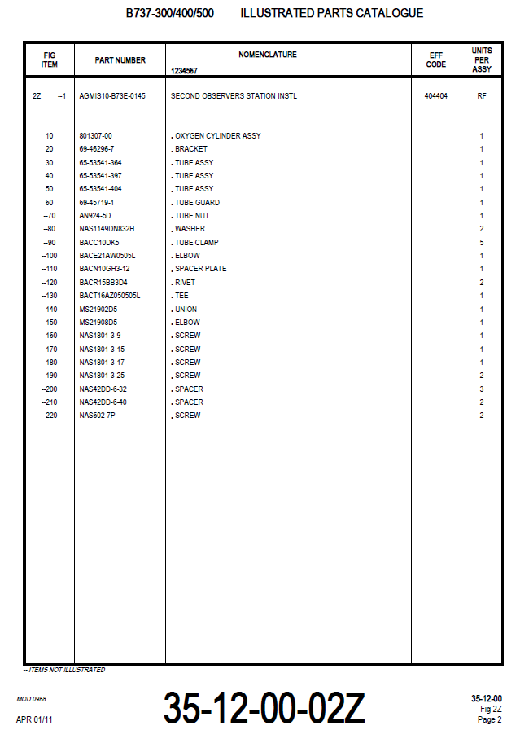
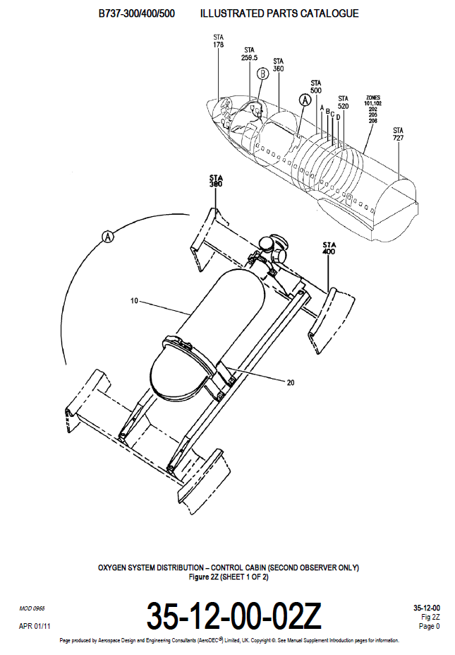
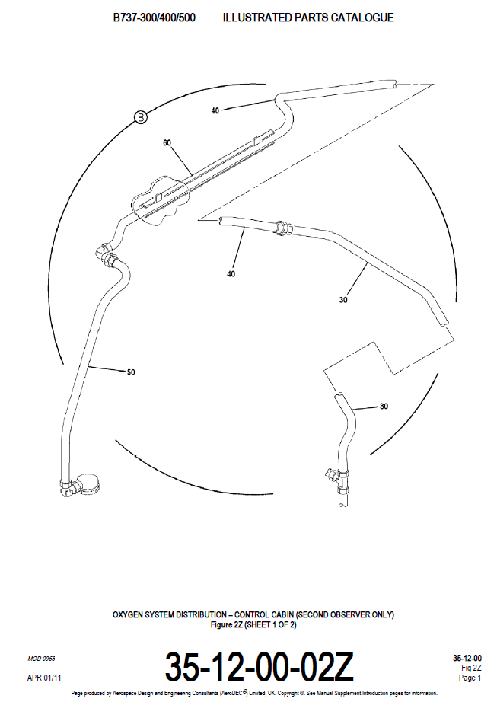
Illustration PartList
AC Locator
Sub Locator
Detail View

Slide 15
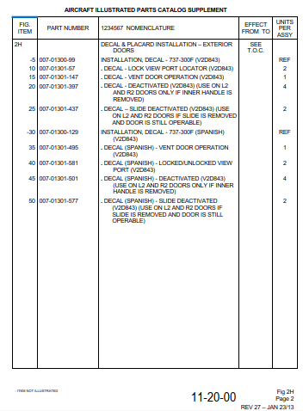
PartList
Fig
Nomenclature
Item Number
Effectivity
Illustrator/Non-Illustrator
Units Per
Assembly
Part Number
Footer Information
Chap-Sec-Sub Fig Number, Page number , Revision Number and Date

Slide 16
IPC Partlist is about Decal and Placard
Partlist has Exterior Decal Installation
This is followed by different detail parts itemized from 10 to 25
Pageblock number is 11-20-00 Figure 01
Figure 01 represents the topic like Decal and Placard
Dash represents Non Ilustrated

Slide 17
AIRCRAFT MAINTENANCE PUBLICATION OR MANUAL
REMOVAL AND INSTALLATION

Slide 18
Aircraft Maintenance Manual (AMM) –
Aircraft Maintenance Manual provides information to enable maintenance personnel to
properly service,
repair,
replace,
adjust,
inspect and
check systems of the aircraft
  1- 99 System Description and Operation
  101- 199 Component Location
  201- 299 Maintenance Practices
  301- 399 Servicing
  401- 499 Removal/Installation
  501- 599 Adjustment/Test
  601- 699 Inspection/Check
  701- 799 Cleaning/Painting
  801- 899 Repairs
PRELIMINARY PAGES
Preliminary pages at the beginning of the AMM contain:
Record of Revisions
Service Bulletin List
Deactivation / Reactivation Index
List of Effective Pages

Slide 19
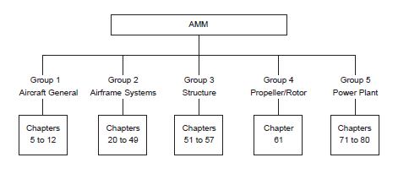
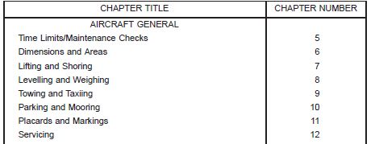
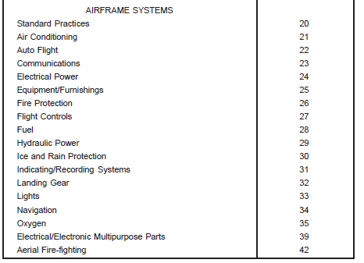
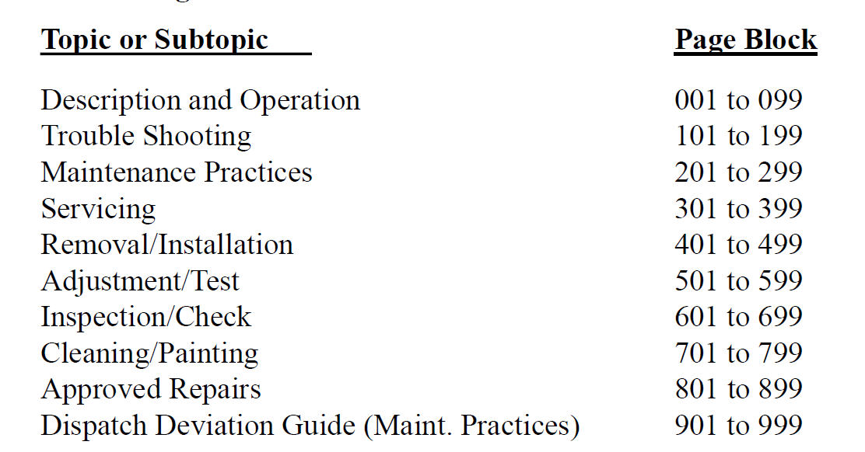
Chapter Numbering
Grouping
Pageblock Numbering

Slide 20
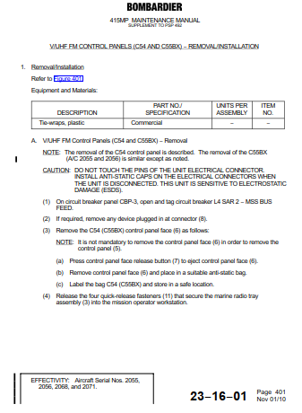
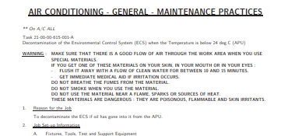
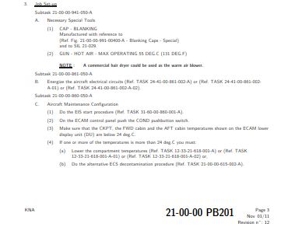
Points to be considered while creating or updating Removal and Installation Pageblocks (all this applicable to all PBs except D/O)
Tasks and Sub-Tasks

Slide 21
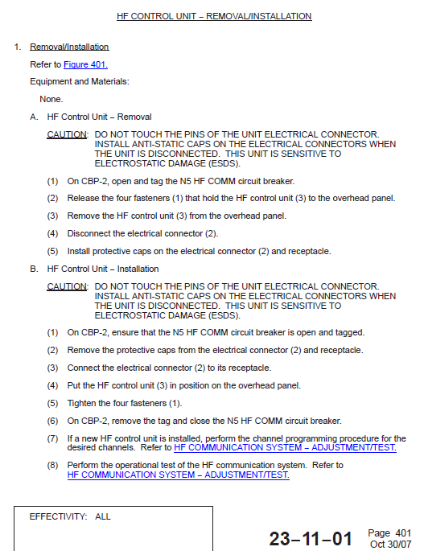
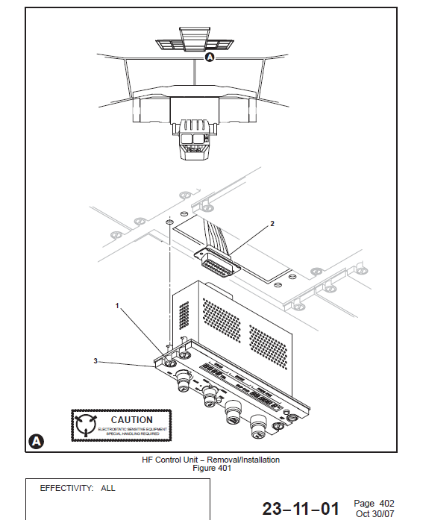
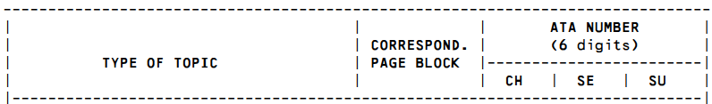
Removal/Installation (401 to 499)
(a) At a Subject/Component Level, this pageblock provides all necessary data for removal, replacement or installation
(b) Removal/Installation procedures have two independent tasks: one for the removal and one for the installation.
(c) The removal/installation are given for the components identified as line replaceable units.

Slide 22

HEADER - Aircraft Model
Title of Pageblock
Equipment and Material
Tools , Consumable and Expendables
Procedures and Information's
Procedure – Steps are actions
Information's – Precautions

Slide 23
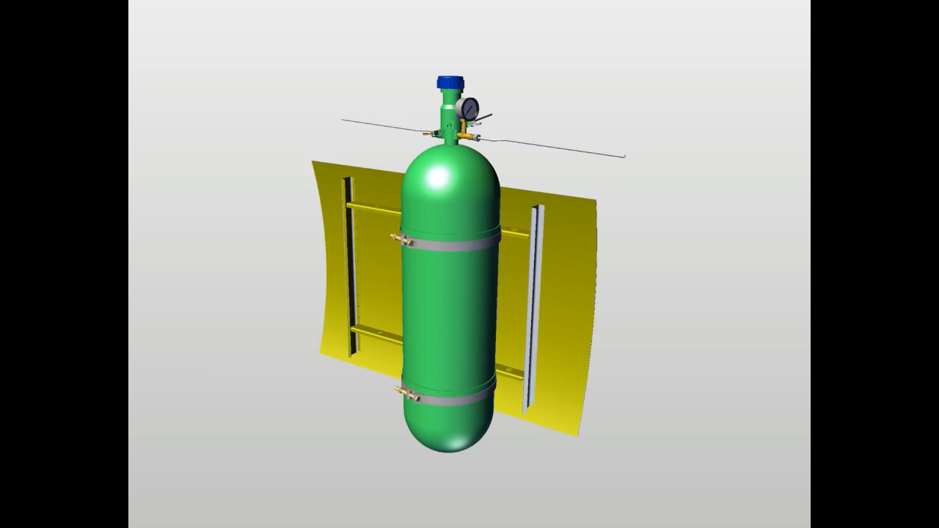

Slide 24

GLOBAL AIRCRAFT 2026 Aircraft Model
Oxygen Cylinder Removal /Installation
HEADER - Aircraft Model
Title of Pageblock
1. Oxygen Cylinder Removal/Installation
Refer to Figure
Reference to Illustration
Equipment and Material
Tools , Consumable
and Expendables
WARNING – DO not use the oil or petroleum lubricants near oxygen
cylinder, it may cause fire
A. Oxygen Cylinder Computer Removal
Procedures and Information's
Procedure – Steps are actions
Information's – Precautions
(1) .Turn the valve knob clockwise, make sure pressure indicator reads zero
(2) .Disconnect the Electrical connector from the receptacle on the cylinder
(3) .Disconnect the tube assembly from the oxygen cylinder. Discard the Oring.
(4) .Loosen the Bolts, Nuts and Washer from the attaching clamp
(5) .Slowly remove the oxygen cylinder from the clamp
(6) .Check the connector pins for any damage or corrosion
35-12-00 P401

Slide 25
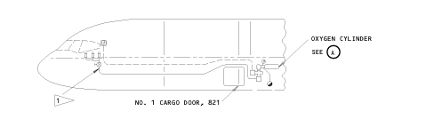
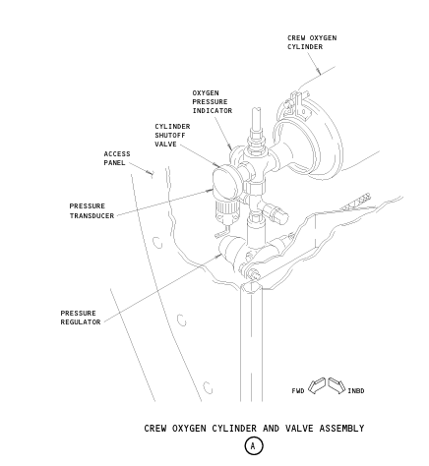
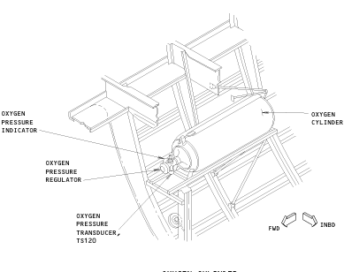

Slide 26


Slide 27
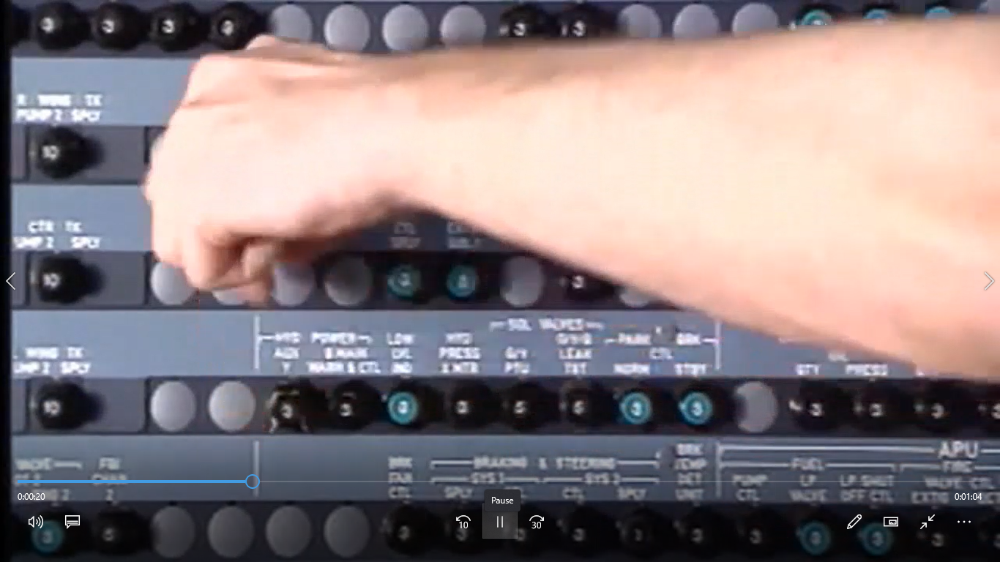
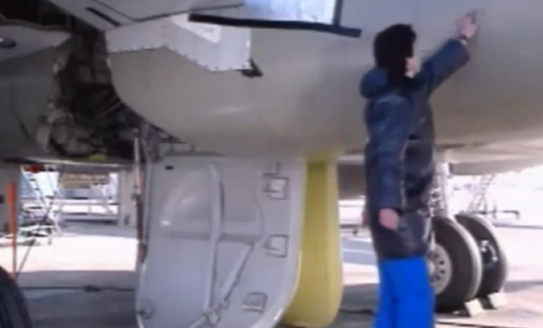


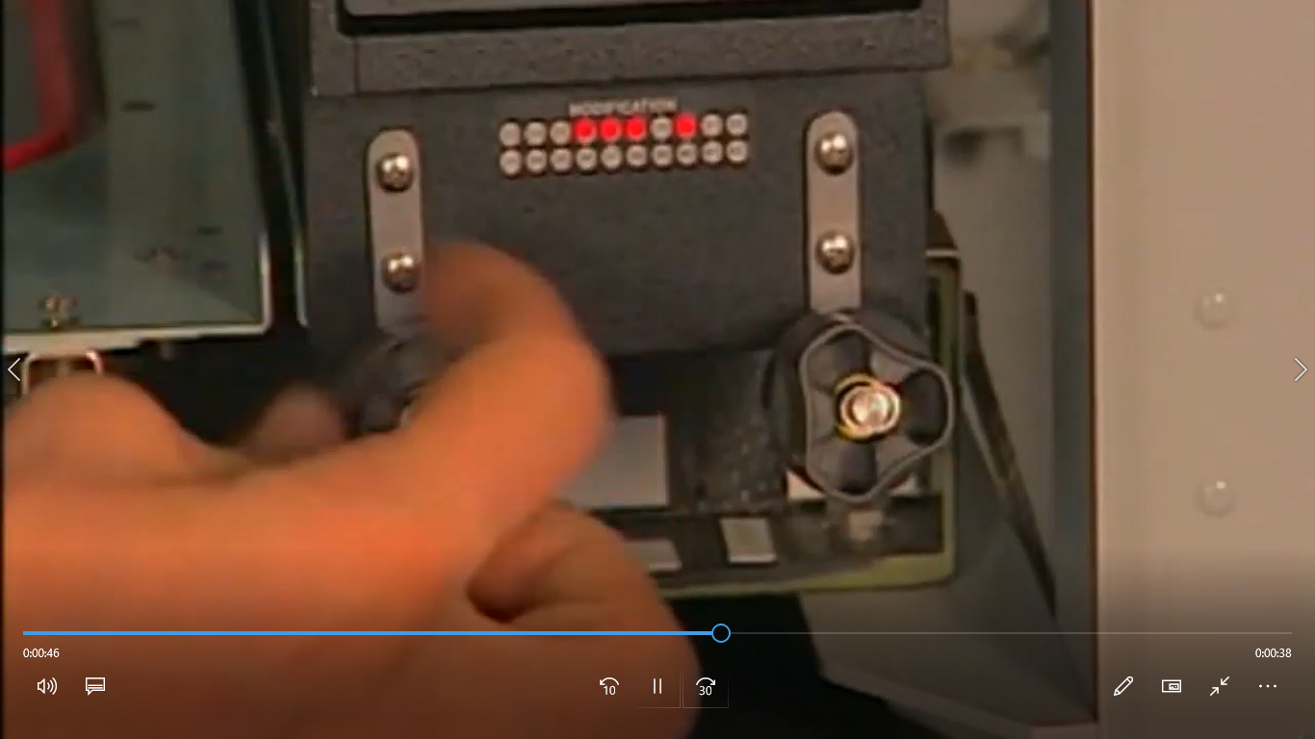
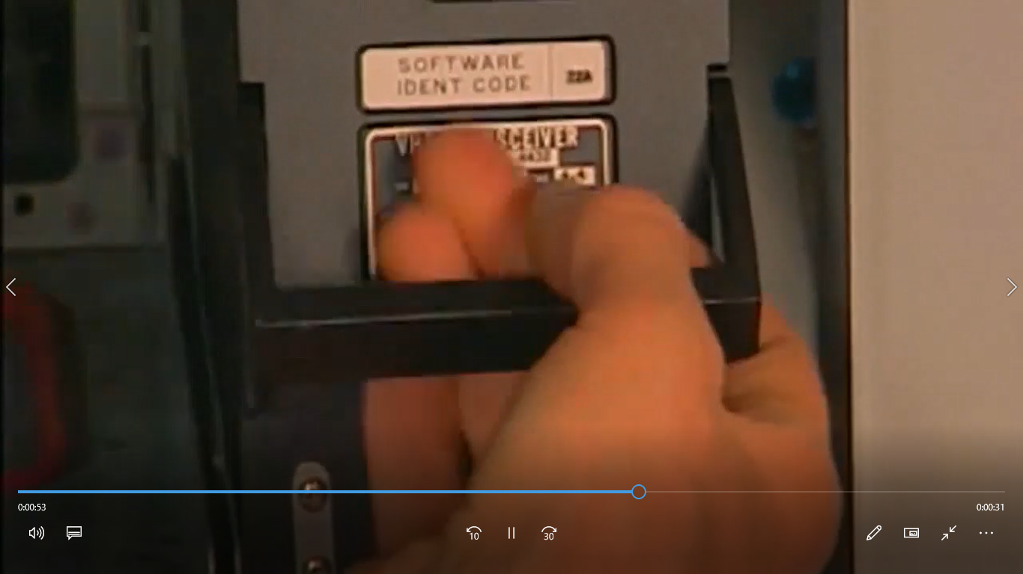
Open and tag the circuit breaker
Remove the Access Panel
Equipment and Material Table
Loosen the Computer Nuts
Hold the Computer Handle

Slide 28
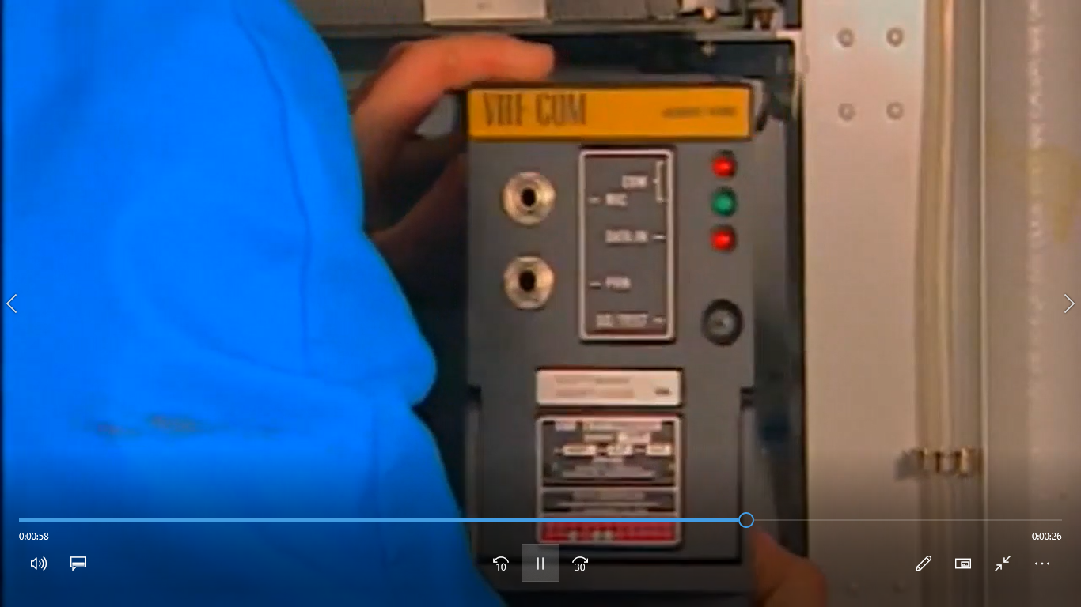
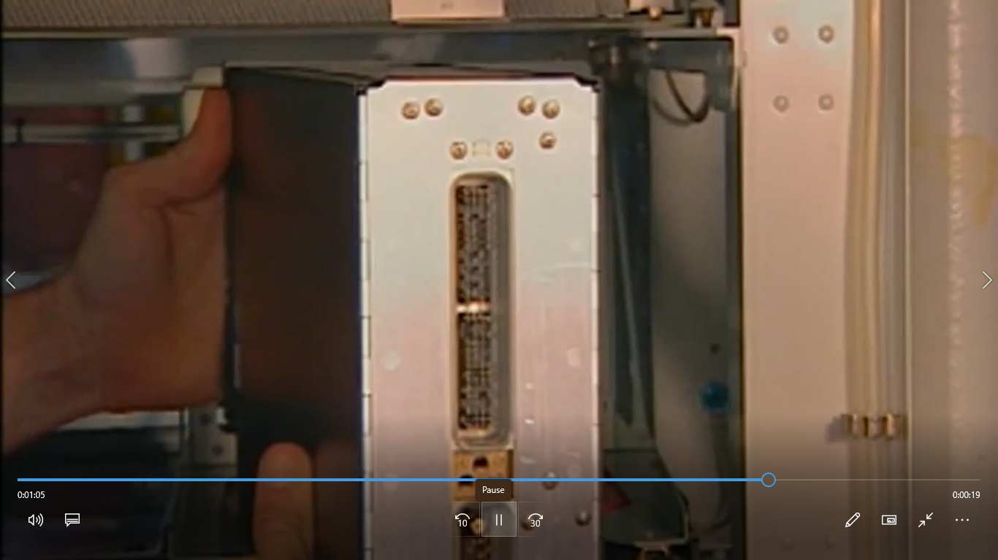
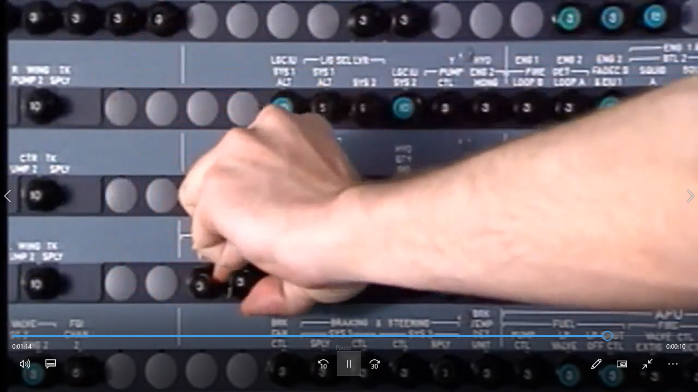
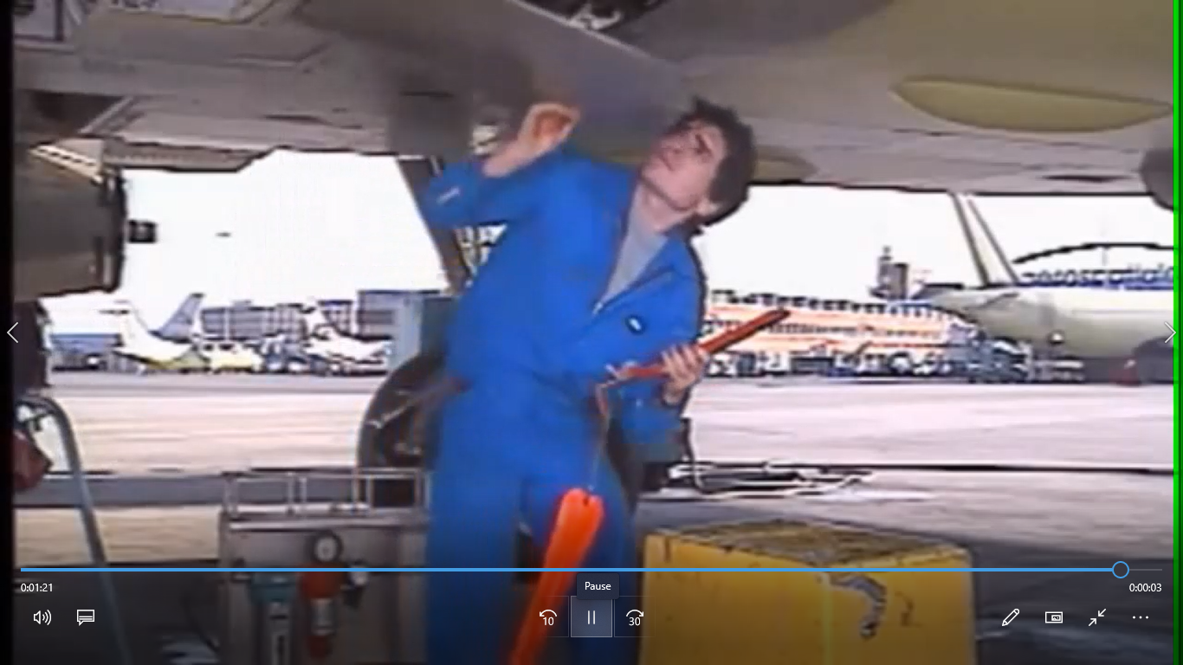
slowly remove the computer from the rack or tray
Check the connector pins for any damage or corrosion
Install the protective caps to the connector
Remove the tag and Close the circuit breaker
Close the Access Panel

Slide 29
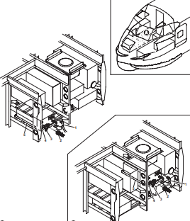
GLOBAL AIRCRAFT 2026 Aircraft Model
VHF Computer Removal /Installation
HEADER - Aircraft Model
Title of Pageblock
1. VHF Computer Removal/Installation
Refer to Figure
Reference to Illustration
Equipment and Material
Tools , Consumable
and Expendables
A. VHF Computer Removal
(1) .Open and tag the circuit breaker
JOB SETUP
(2) .Remove the Access Panel
(3) .Loosen the Computer Nuts
(4) .Hold the Computer Handle
Procedures and Information's
Procedure – Steps are actions
Information's – Precautions
(5) .Slowly remove the computer from the rack or tray
(6) .Check the connector pins for any damage or corrosion
(7) .Install the protective caps to the connector
(8) .Remove the tag and Close the circuit breaker
(9) .Close the Access Panel
CLOSEOUT

Slide 30
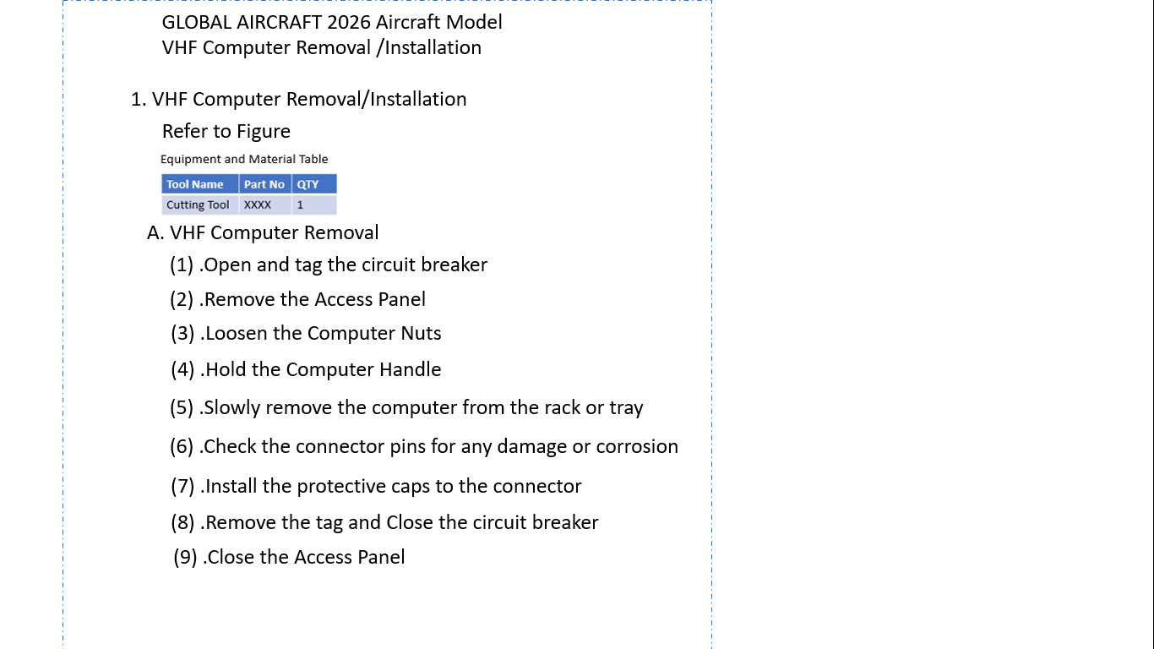
PB 23-10-01 P401

Slide 31
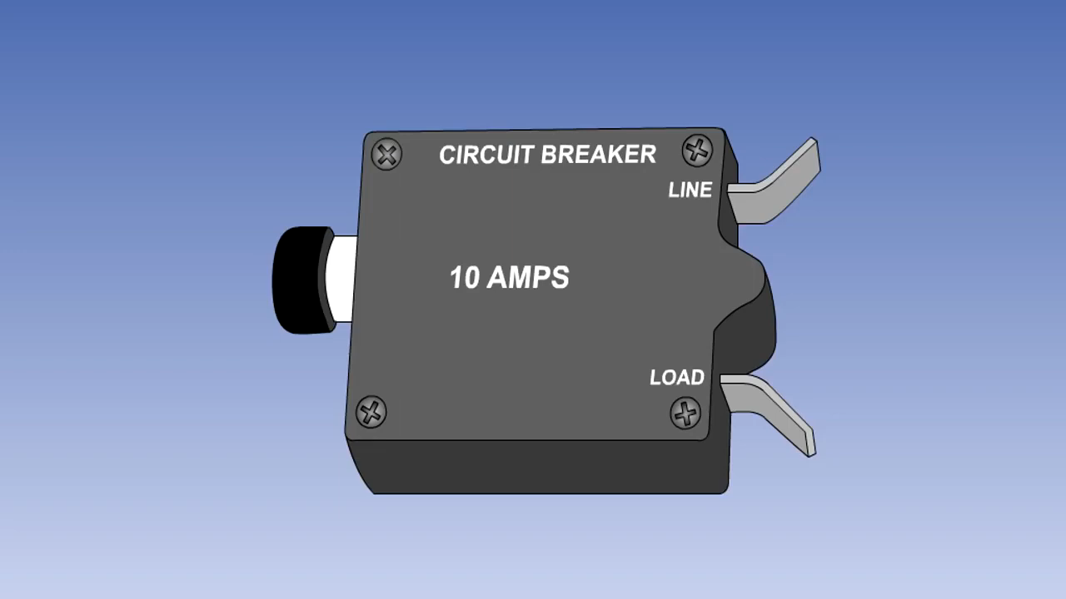

Slide 32
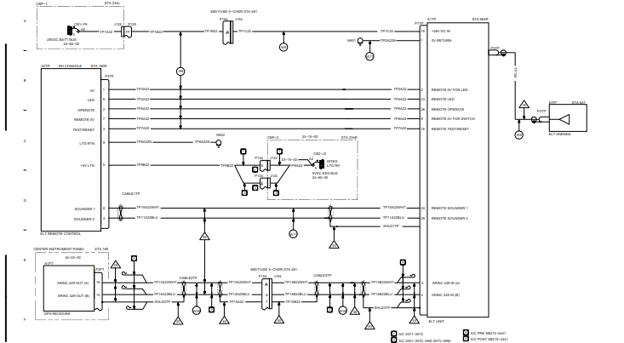
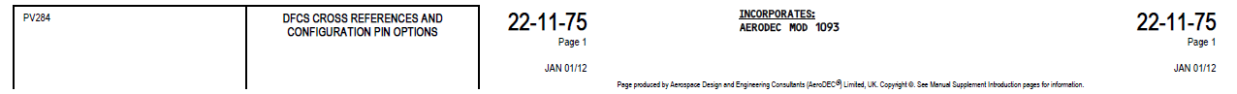
Power Source
Source Unit
Location, Elect Ident
Unit Nomenclature
Unit Connector
Signal Number
Wire Numbers
Effectivity Block

Slide 33
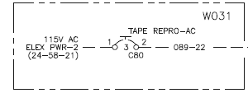
Circuit Breaker Name – TAPE REPRO - AC
Circuit Breaker Busbar – 115V AC
Circuit Breaker Rating – 3 Ampere
Circuit Breaker Number – C80

Slide 34
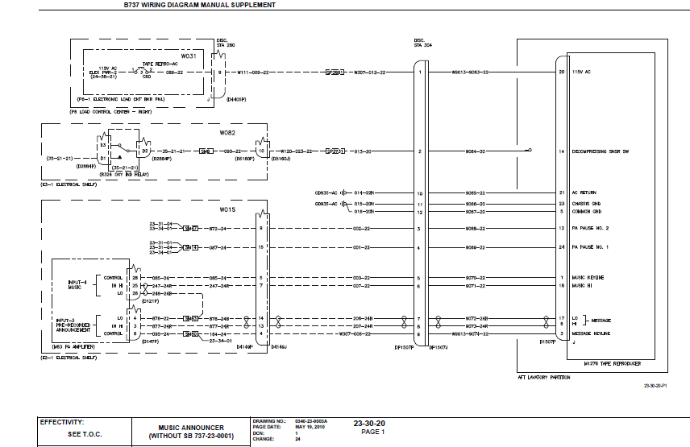
System Name – Music Announcer
Pageblock Number - 23-30-20 P1

Slide 35
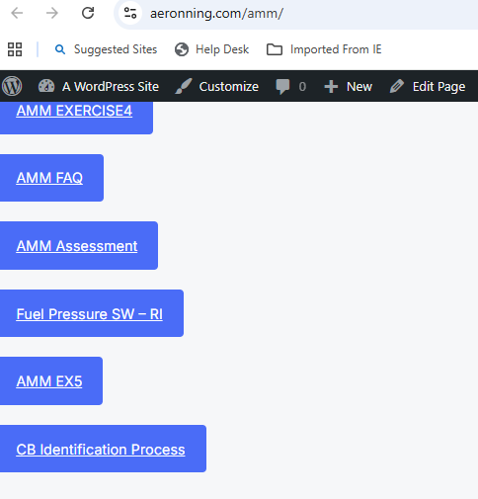
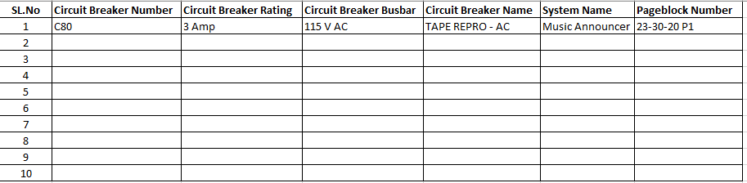
https://aeronning.com/amm/

Slide 36
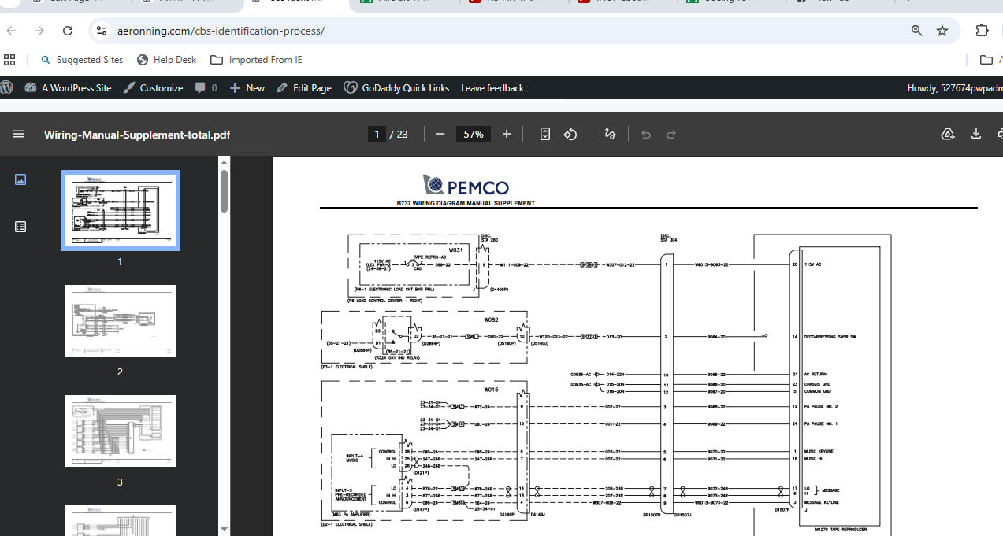

Slide 37



TOOLS
Used during the task for any action
Consumable Material List of materials and supplies that are used during maintenance tasks but are not permanently installed on the aircraft
Expendable parts are low-cost components designed for single-use or a limited service life
Tools - Screw Driver ,
Spanner
Wrinch
Hammer
Lubricating Oils
Cleaning Agents
Adhesives
Seals & O-Rings
Gaskets and
rubber seals

Slide 38
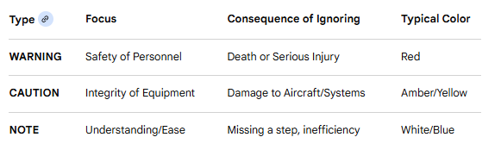
Information's – Precautions

Slide 39

Procedure – Steps are actions

Slide 40


Slide 41


Slide 42


Slide 43


Slide 44


Slide 45



Slide 47


Identify the difference in Installation between the below 2 configuration

Slide 48

3
2
1

Slide 49



