Slide 2
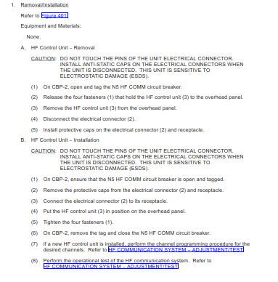
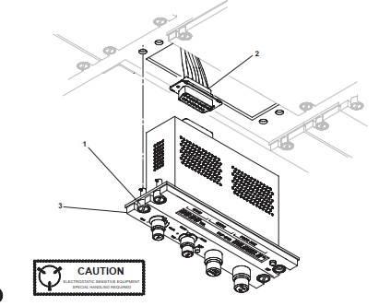
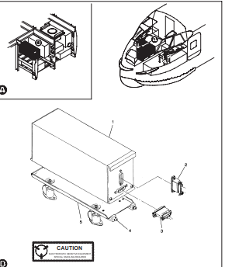
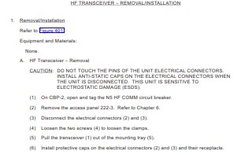
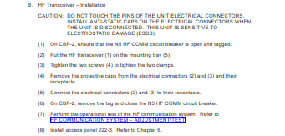
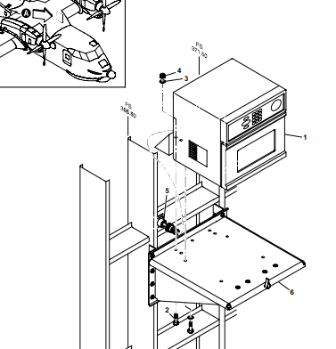
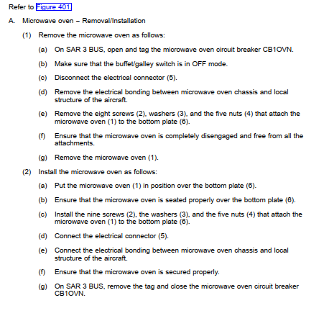
Common Sentence

Slide 3
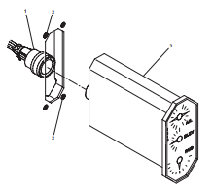
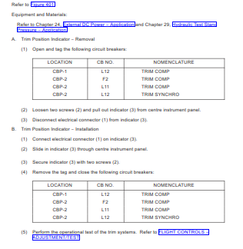

Slide 4
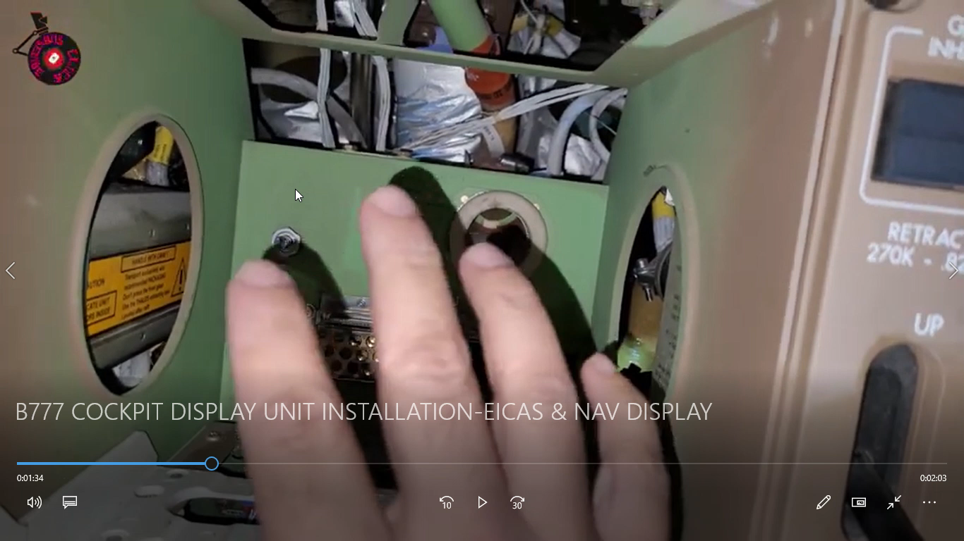

Slide 5
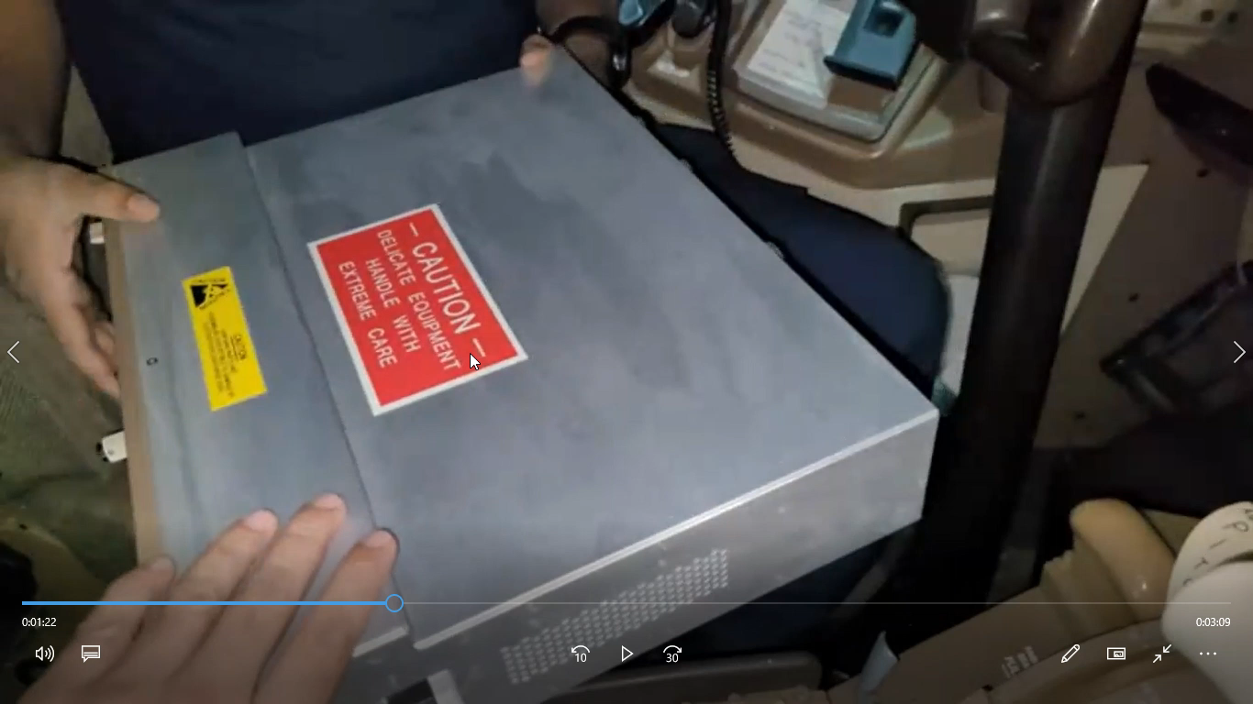

Slide 6


Slide 7
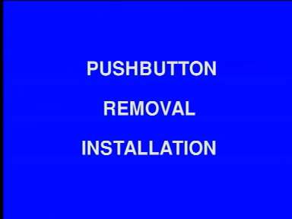

Slide 8
Pageblock, Task and Sub-Task
pageblock refers to a specific section or block of pages within the manual that is dedicated to a particular topic or set of related topics
task refers to a specific maintenance activity or procedure that needs to be performed on the aircraft to support pageblock topic.
Removal /Installation
Removal
OPEN
CLOSE
Installation
OPEN
PAGEBLOCK (CSS_PB)
TASK (CSS_FC_UI)
JOB SETUP
CLOSE
JOB SETUP

Slide 9
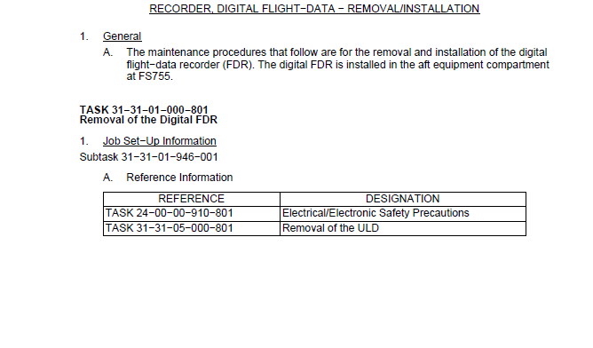
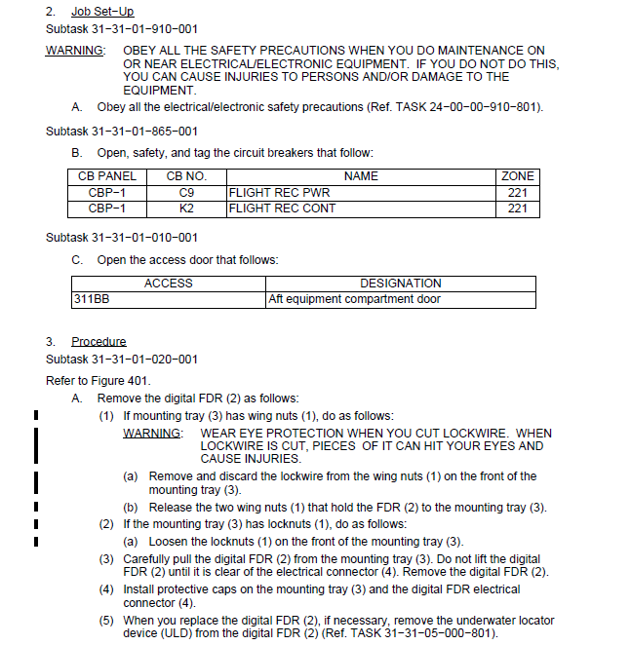
ATA Pageblocks
iSpec Pageblocks

Slide 10
ATA Pageblocks
iSpec Pageblocks
Step 2 to 5
Step 2 to 5

Slide 11

iSpec Pageblocks
General
Single line task description
TASK No 23-XX_XX_XXX-XXX
Removal of VHF Antenna
Ref Information

Slide 12
iSpec Pageblocks
TASK No 23-XX_XX_XXX-XXX
Installation of VHF Antenna
Procedure
Sub task 24-XX-XX-XXX-XXX
Closeout
Sub task

Slide 13
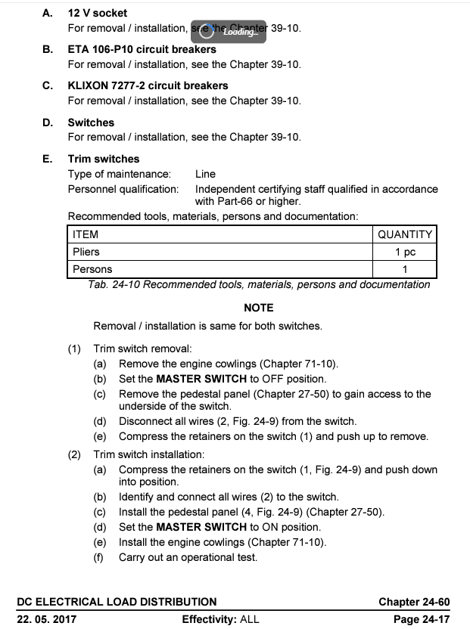
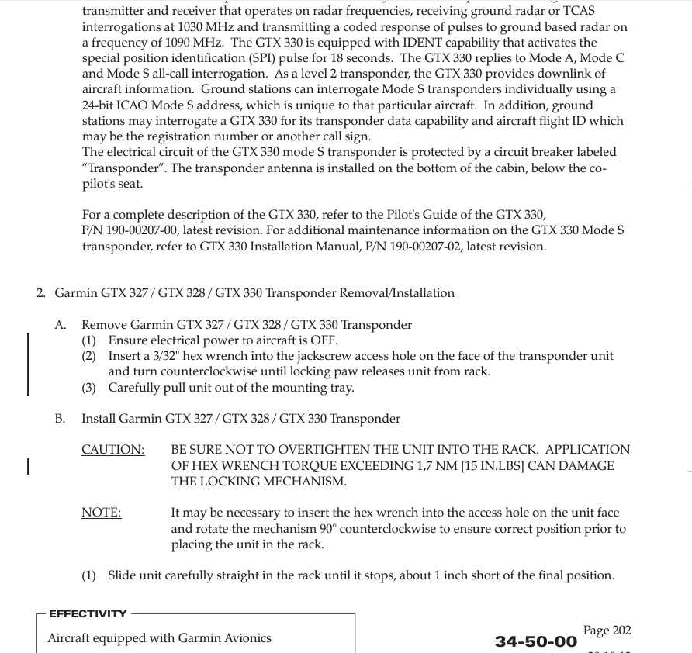
iSpec Pageblocks
ATA Pageblocks

Slide 14
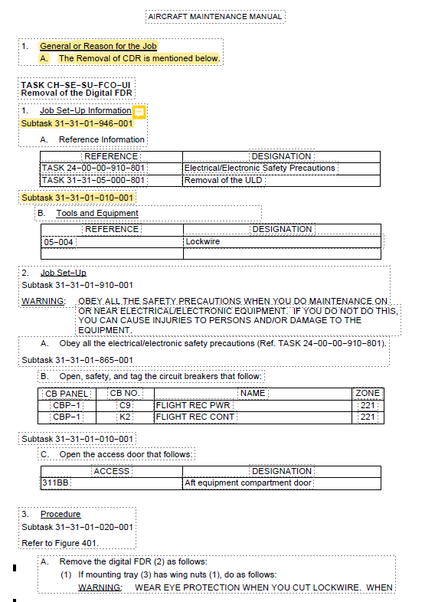
Standard DTD
iSpec Pageblocks
DTD Template
ATA Pageblocks
Highlighted parts are
optional,Means few
AC use it

Slide 15
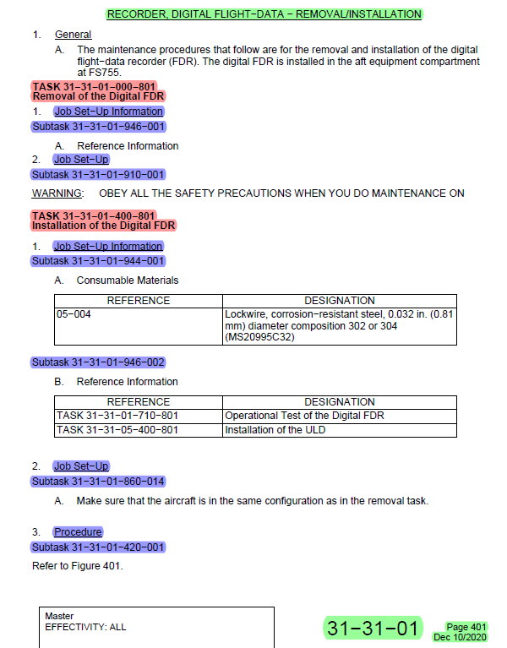
Pageblock, Task and Sub-Task
pageblock refers to a specific section or block of pages within the manual that is dedicated to a particular topic or set of related topics
task refers to a specific maintenance activity or procedure that needs to be performed on the aircraft to support pageblock topic.
Removal /Installation
Removal
OPEN
CLOSE
Installation
OPEN
PAGEBLOCK (CSS_PB)
TASK (CSS_FC_UI)
SUB-TASK(CSS_FC_UC)
JOB SETUP
CLOSE
JOB SETUP
sub-task is a more detailed and specific activity that forms part of a larger maintenance task. Each sub-task breaks down the main task into smaller, manageable steps to ensure precision and accuracy during the maintenance process.

Slide 16
Points to be considered while creating or updating Removal and Installation Pageblocks
Removal and Installation – Structure
Task Number for Removal
Task Name
Reason for the Job
Job Setup Information
Consumable Material List
Expendables Parts
Referenced Information
Job Setup
Subtask Number for setup
(Access panels, CBs,..)
Removal Procedure
Task Number for Installation
Task Name
Reason for the Job
Job Setup Information
Consumable Material List
Expendables Parts
Referenced Information
Job Setup
Subtask Number for setup
(Access panels, CBs,..)
Installation Procedure
Close out (Return to Service)
Closing of Panels, CBs.
Reverse of Job setup
Removal and Installation are each one task
respectively
Always Removal task will be first
Between both tasks, illustration will be there
Illustration will be always common for both tasks
Illustration will be shown in dis-assembled view
Removal Procedures will not have closeout
In Case of LH/RH , No 1 and No 2, only one is
depicted
This example is of iSpec Standard.
ATA and S1000D examples will be detailed during Tech pub Standards class

Slide 17



Points to be considered while creating or updating Removal and Installation Pageblocks
Reason for the JOB :
It provides the maintenance technician with the context and background information about why a particular maintenance task is being performed. This helps the technician understand the importance and relevance of the task.
This is not a mandatory field, depends on OEMs decisions.
Few of the Reason for the job are as below –
MMEL Reference
Access Purpose
MPD Reference
Safety Purpose

Slide 18
Points to be considered while creating or updating Removal and Installation Pageblocks
Job Setup Information
Consumable Material List
Expendables Parts
Referenced Information
** Tools and Equipment
** Safety Precautions and Access Information
Consumable Material List of materials and supplies that are used during maintenance tasks but are not permanently installed on the aircraft.
These materials are typically consumed or used up during the maintenance process and need to be replenished regularly.
The list ensures that technicians have the necessary materials to perform tasks efficiently and in compliance with the manufacturer's specifications.

Slide 19
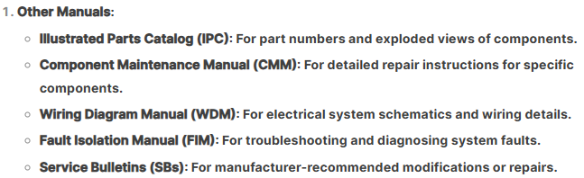
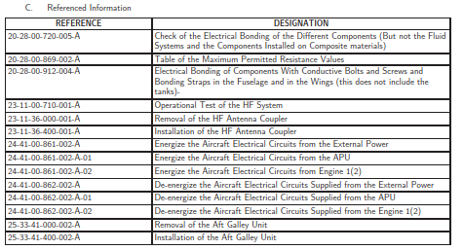
Points to be considered while creating or updating Removal and Installation Pageblocks
Referenced Information
Referenced Information" refers to cross-referenced within the manual to provide further details, instructions, or context for a specific task or procedure. This information is essential for ensuring that maintenance personnel have access to all necessary resources to perform their work correctly, safely, and in compliance with regulatory requirements.

Slide 20
Procedure - Other KEY POINTS

Slide 21
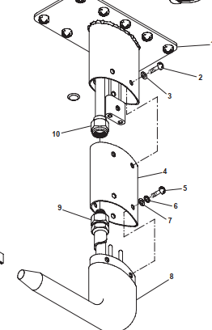
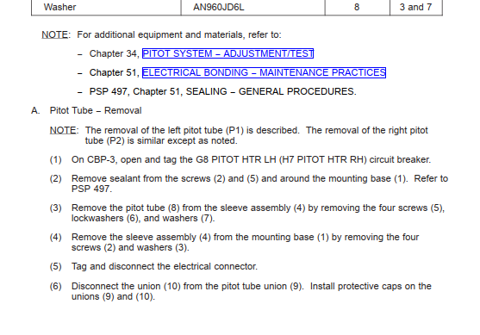
Procedure - Other KEY POINTS
Procedural steps to follow Simplified Technical English (STE). In case of S1000D, ASD-STE standard to be followed.
Each Aircraft Program will have its own Authoring and illustration style-guides.
In case of attaching parts, same step to cover removal or installation for all the parts together
Example – Install the screw (X),the washers(X) and the bolt(X) and tighten them.

Slide 22
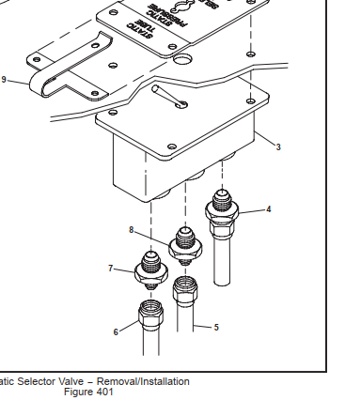
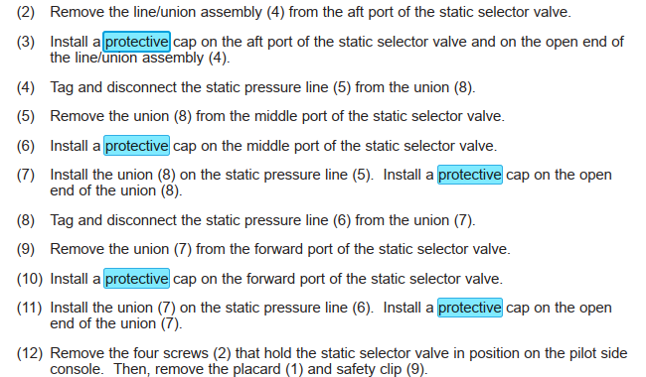
Procedure - Other KEY POINTS
All Electrical Connectors, Plugs, Tubes and Pipelines after removal to be capped for safety and dust accumulation prevention.
The Cap for the same will be part of the consumable table.

Slide 23
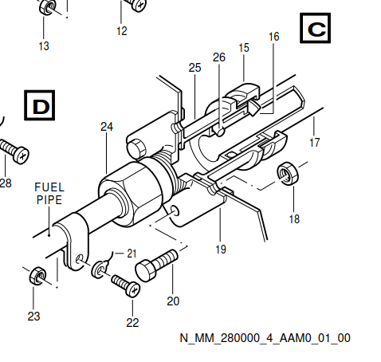
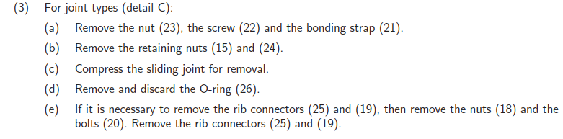
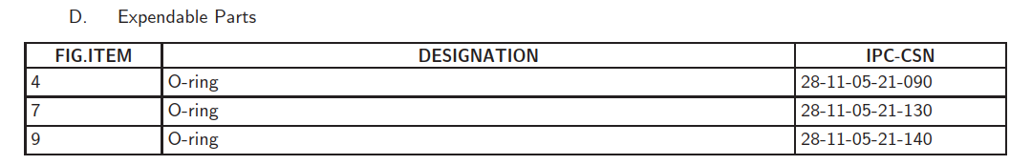
Procedure - Other KEY POINTS
All the Washers, Seals, and rubber materials like O-rings, Gaskets are to be inspected after removal. In case if it is worn or damaged, to be replaced.
Details of these Washers, Seals and rubber materials to be available in the expandable table or part of the referenced information AIPC pageblocks.
NOTE - Will be discarded directly or after inspecting the expendables based on engineering recommendations.

Slide 24
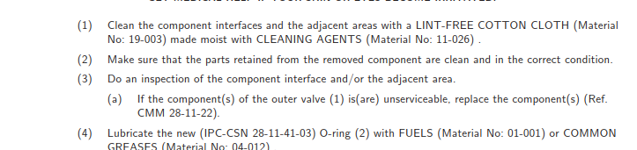
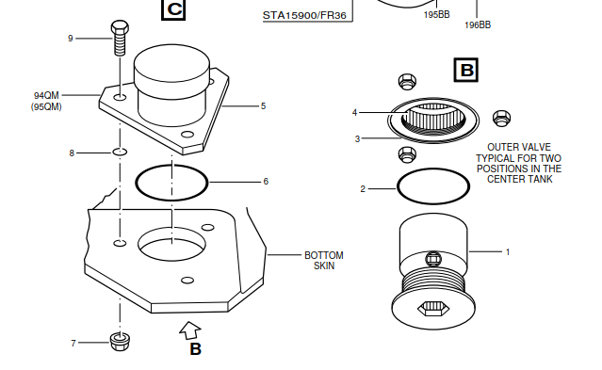

NOTE – In some cases, this expendables details will be part of Caution before the task

Slide 25
CLOSE OUT
Close out is opposite to the Job setup process , and is also called Return to service action.
Close out normally brings backs the aircraft to its flying or service status.
It Includes activities like
Inspection of expendables and replacing
Removing Test Kits, Jigs, Stands..
Deenergize External Power Supply
Circuit Breakers Closing
Access Panels Closing
Software Loading
Performing Servicing activities like Bonding, Lubrication, .
Performing Adjustment/Test
All Job setup activities can be redone in reverse order along-with other specified activities.
Notes
Only Installation task will have the closeout , not the Removal task.

Slide 26
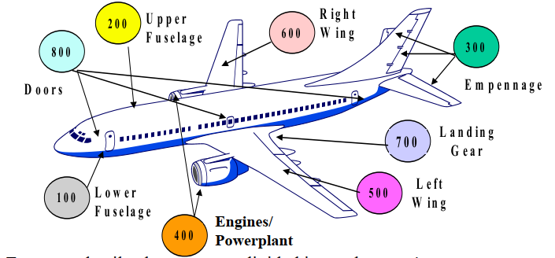
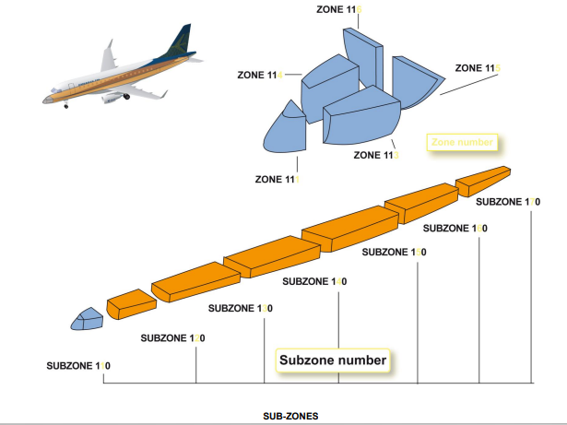
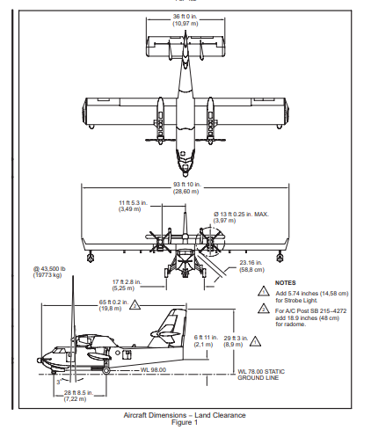
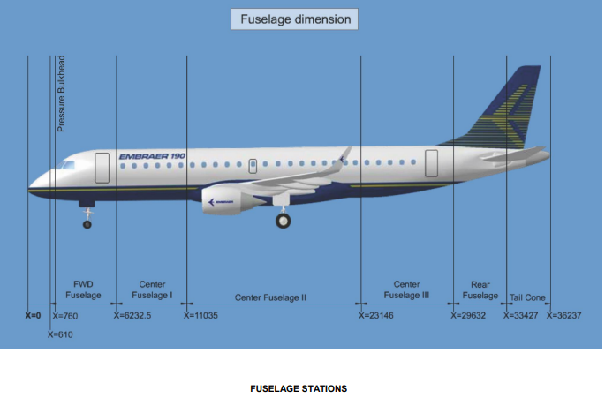
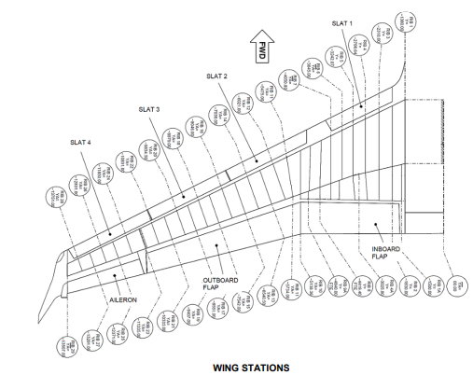
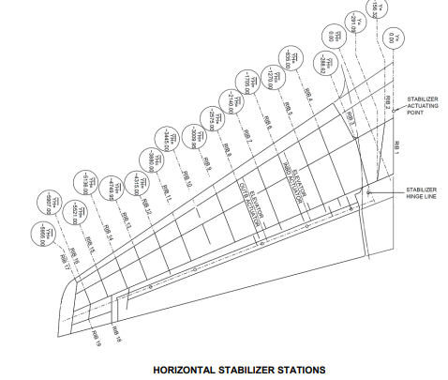
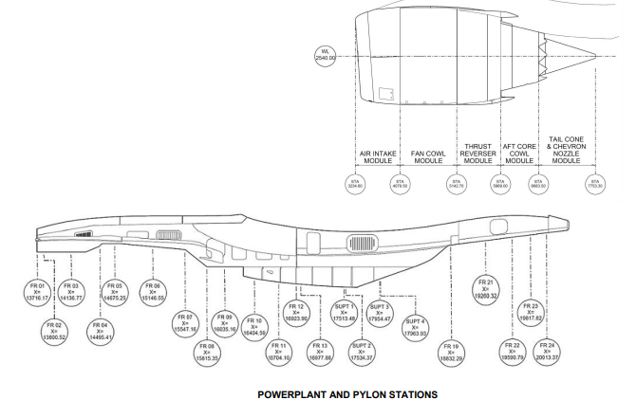
Dimensions and Areas
Areas
SUB-ZONE Numbering
Chap 6
ZONE Numbering

Slide 27
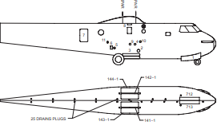
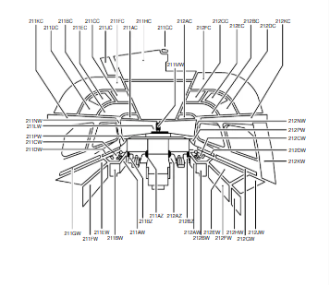
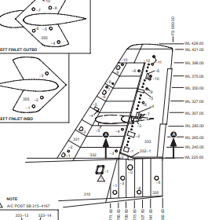
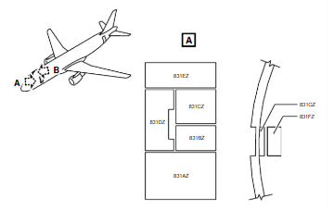
Access to servicing, inspection or maintenance points is provided through quick release or removable doors and panels
Chap 6
FUSELAGE ACCESS PANELS
COCKPIT ACCESS PANELS
DOOR ACCESS PANELS
STABILIZER ACCESS PANELS
These Access Doors and Access Panels are numbered as 5 digit. First three digits represent the zone number and suffix
Numbers which follow the dash , indicate the access door or panel number.
Ex : 250-6 indicates the access panel -6 belongs to the aircraft zone 250

Slide 28
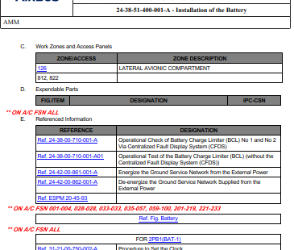
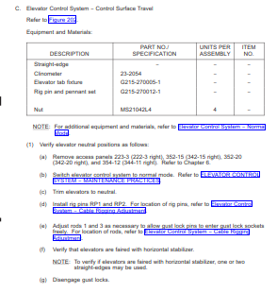
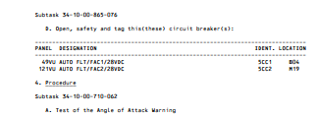

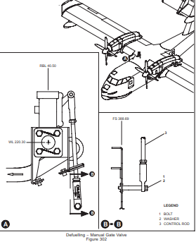
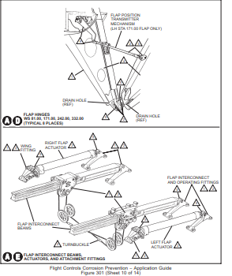
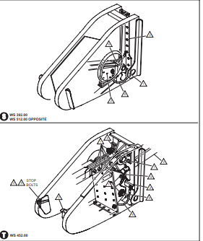
PANEL NUMBERING Example
STATION NUMBERING Example

Slide 29
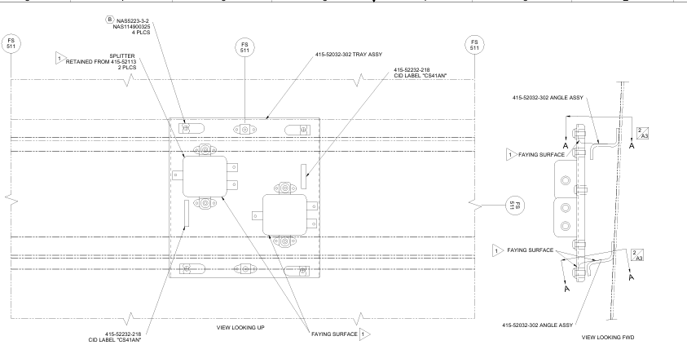

Slide 30
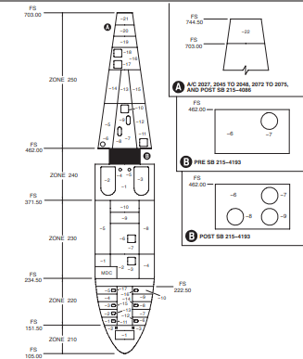
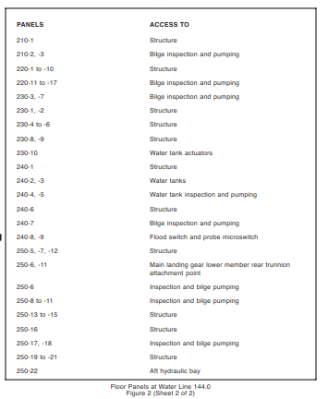

Slide 31


ACTIVE: The side stay holds the main gear leg.
PASSIVE: The main gear leg is held by the side stay.

Slide 32
The side stay holds the main gear leg.
The main gear leg is held by the side stay.

Slide 33
Keep procedural sentences as short as possible.
(20 words maximum)
After you have removed the electrical power from the system, make sure that the refueling panel switches go back to their normal position.
(Twenty-three words)
Right:
(1) Remove the electrical power from the system.(Seven words)
(2) Make sure that the refueling panel switches go back to their correct position. (Thirteen words)

Slide 36
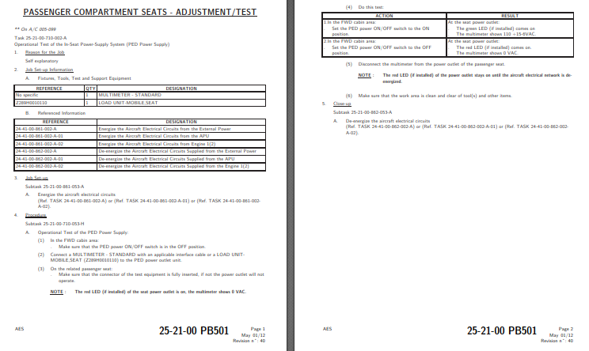
Adjustment/Test (501 to 599) - There are three types of tests: operational, functional, and system.
Operational Test -
Procedure required to ascertain only that a system or unit is operable.
These tests should require no special equipment or facilities other than that installed on the aircraft.
Example – Built In Test Equipment's , HF or VHF Communication Checks

Slide 41


Slide 44




Slide 45





Slide 51
Team 1 | AMM | Description and operation
Team 2 | AMM | Maintenance Practices
Team 3 | AMM | Servicing
Team 4 | AMM | Removal/Installation
Team 5 | AMM | Adjustment/Test
Team 6 | AMM | Inspection/Check
Team 7 | AMM | Cleaning/Painting
Team 8 | AMM | Repairs
Team 9 | FCOM | Flight Crew Operating Manual FCOM
Team 10 | SRM | Structure Repair Manual
Team 11 | WDM | Wiring Diagram Manual
Team 12 | FIM | Fault Isolation Manual
Team 13 | NDT | Non Destructuve Manual
Team 14 | CMM | Component Maintenance Manual
Team 15 | AFM | Airplane Flight Manual
What is the Definition ?
Purpose?
Detail?
Snap or Image
Pageblock numbering

Slide 52
What is AIPC ?
AIPC is abbreviated as Aircraft Illustrated Parts Catalogue. It is a companion manual to Aircraft maintenance manual.
What is the purpose of AIPC?
The AIPC lists, describes and illustrates assemblies, sub-assemblies and detailed parts(Temporary fastened only) of the aircraft. It is intended for use in requisitioning, issuing, identifying parts, and in illustrating assembly relationships.
What are the general rules for AIPC ?
AIPC includes all parts for which maintenance practice has been provided. IPC does not contain data related to the overhaul of the components or the repair of the aircraft structure and also Ground support Equipment.
What is the general structure or template of AIPC?
AIPC has three sections: -
Alpha Numerical Index , Introduction and IPC Chapters 00 to 80.
Each Pageblock has Illustration first and then followed by Part list.
Details of Figure Number, Item Number, Part Name, Part Number, Effectivity and QTY ?
Figure Number represent the pageblock numbering in AIPC.
Item Number is the sequential numbering of parts and an connection between illustration to part list connectivity.
Part Number and Name are the Engineering drawing identified number and name of part, assembly, sub assembly and installation.
Effectivity is the Aircraft Serial Number for which the part, assembly, sub assembly and installation are applicable.
Quantity referred as UPA(Unit per Assembly) is the number of detail parts per assembly.
TQA is abbreviated as Total Quantity per Aircraft is the total number of parts on the aircraft.

Slide 53


What is locator, sub locator and leader lines in illustration?
Illustration in each page block is assigned a figure number commencing with Figure 01 and progressing sequentially.
Locator is the high level (aircraft or fuselage or wing) representation of the location of. This guides to the
What are Interchangeability codes , explain each?
  Five interchangeability codes:
      CODE 1, One way interchangeable
If Part X is no more available or vendor/supplier not supplying/manufacturing . In that scenario different part variant, parts number Or supplier provided parts are considered to superseded.
      CODE 2, Two way interchangeable

Slide 54




      CODE 3, Not Interchangeable
      CODE 4, Interchangeable as a set
      CODE 5, Qualified interchangeability

Slide 55


What is Attaching part, alternate and Optional Part?
Electrical Identification code,
Unique Code provided for all Electrical and electronic part/components to co-relate the Wiring and Part Catalogue manuals.
Supplier (vendor) code,
Codes given by Aircraft OEMs for all its suppliers to take care of digital data identification and tracking.
Source Control Drawing SCD
This is the supplier or the parts OEM drawings describing the part drawing and its related Aircraft OEM part numbering.

